Slide 1


Slide 2
Fundamentals of Ecology
Week 9, Ecology Lecture 8
Cara Brook
March 6, 2025
Office hours: On ZOOM
Thursday, March 6, 2025
4-5pm
See link in Canvas!

Slide 3
Learning objectives from Lecture 8
You should be able to:
Given a model diagram, recognize if the disease is transmitted directly or has a vector or animal reservoir
Identify a reservoir, zoonosis, spillover, or spillback in a description or diagram
Explain the virulence-transmission tradeoff
Explain/recognize a dilution effect
Understand zooprophyllaxis

Slide 4
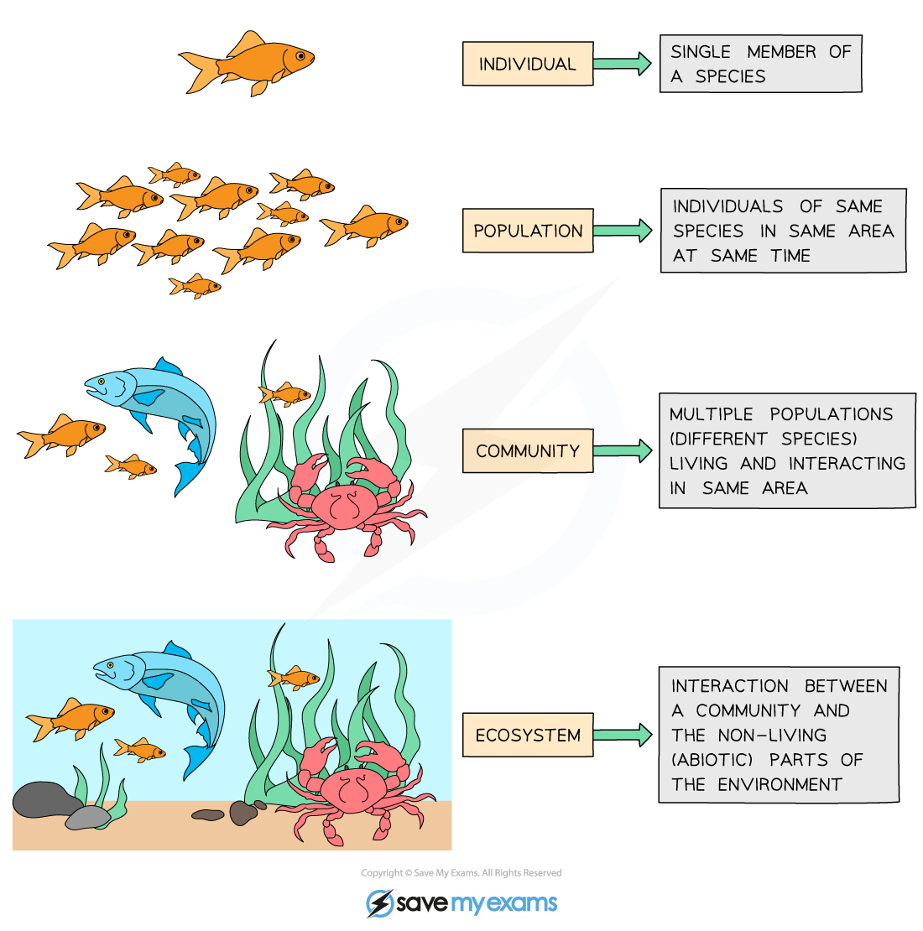
Ecology is the study of the interactions of organisms with each other and their environment.
individual
population
metapopulation
community
ecosystem
Notes:
We explore ecology – using models – across scales

Slide 5
Ecosystem = communities interacting with the abiotic environment
individual
population
There is often less emphasis on the box model approach and more of a conceptual model approach to explain the distribution and abundance of species in space and time, sometimes using equations.
metapopulation
community
ecosystem
Notes:
At the bottom, there is the level of the individual. Since ecology concerns interactions of organisms with each other and the environment, here we means how an in individual interacts with the environment

Slide 6
Ecosystem = communities interacting with the abiotic environment
individual
population
There is often less emphasis on the box model approach and more of a conceptual model approach to explain the distribution and abundance of species in space and time, sometimes using equations.
metapopulation
community
How do communities assemble?
Do a predictable number or type of species end up in a given environment?
ecosystem
Notes:
At the bottom, there is the level of the individual. Since ecology concerns interactions of organisms with each other and the environment, here we means how an in individual interacts with the environment

Slide 7
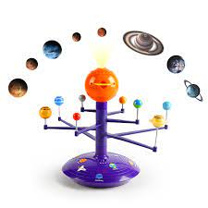
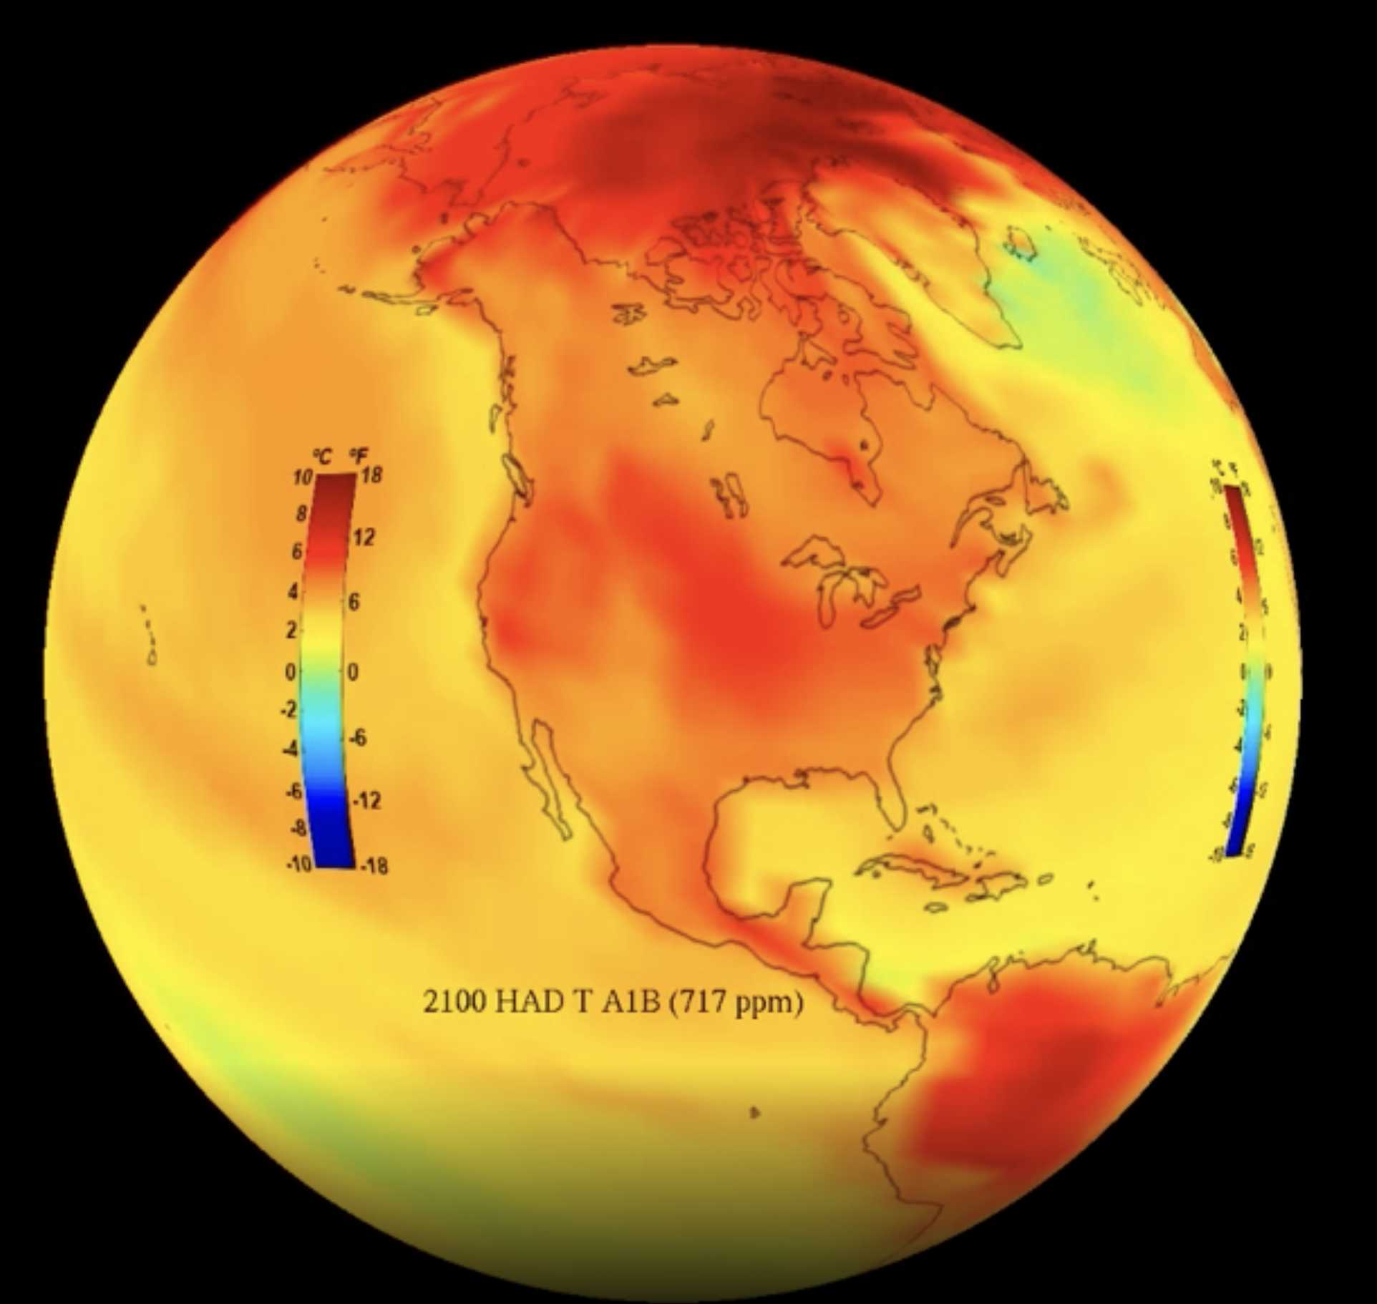

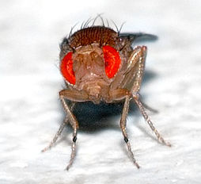
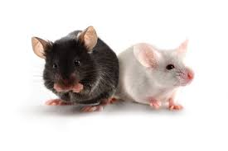
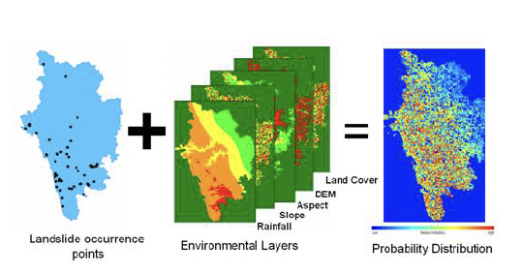
What is a model?
an abstract representation of a phenomenon
Solar System
Climate
Human
Human Genetics
Human Disease
Species Distribution
Notes:
an abstract representation of a phenomenon

Slide 8
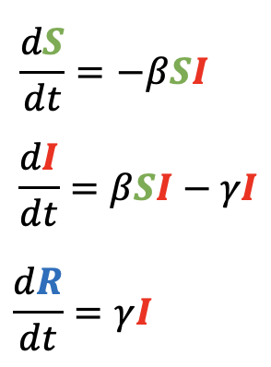
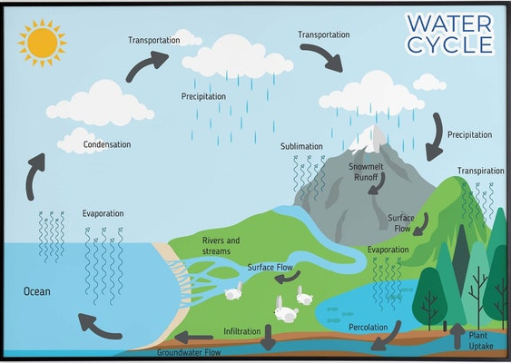
What is a model?
an abstract representation of a phenomenon
Human
Solar System
Mathematical
Human Genetics
Human Disease
Conceptual
Notes:
an abstract representation of a phenomenon

Slide 9
Community assembly is the study of the processes that shape the identity and abundance of species within ecological communities.

Slide 10
Community assembly is the study of the processes that shape the identity and abundance of species within ecological communities.
One process of community assembly is ecological succession.

Slide 11
One process of community assembly is ecological succession.
Succession is the process of change in the species structure of ecological communities with time.

Slide 12
One process of community assembly is ecological succession.
Succession is the process of change in the species structure of ecological communities with time.
Community begins with pioneer species, then develops with increasing complexity that self-reinforces to establish a climax community.

Slide 13
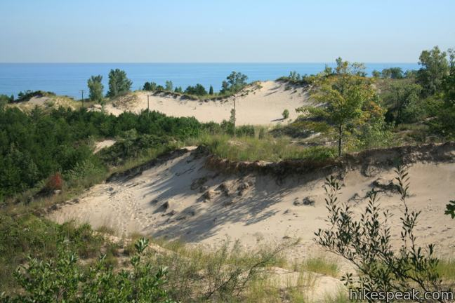
One process of community assembly is ecological succession.
Succession is the process of change in the species structure of ecological communities with time.
Community begins with pioneer species, then develops with increasing complexity that self-reinforces to establish a climax community.
Henry Chandler Cowles, a professor at the University of Chicago, developed the first formal concept of succession while observing vegetation on dunes of different ages at the Indiana Dunes. Differently aged dunes offered a proxy for time.

Slide 14
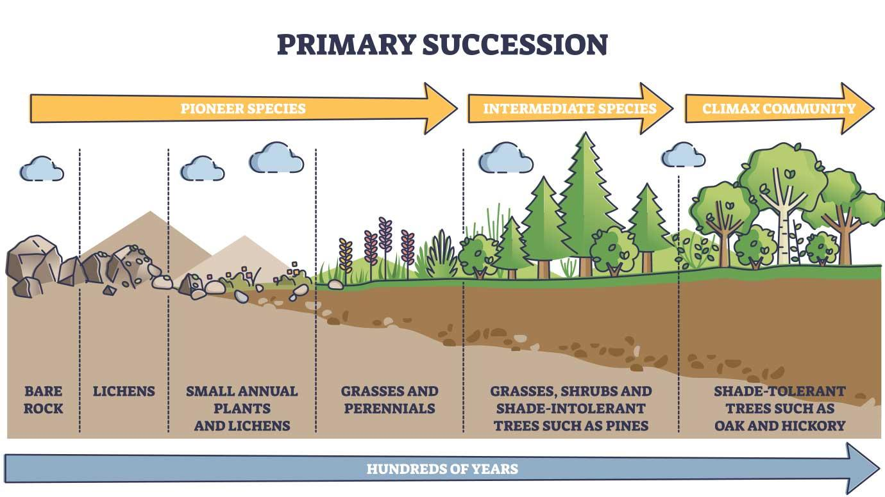
Primary succession occurs when species colonize a bare substrate.

Slide 15
Primary succession occurs when species colonize a bare substrate.
Continuum from “r-selected” $→$ “K-selected” species.

Slide 16
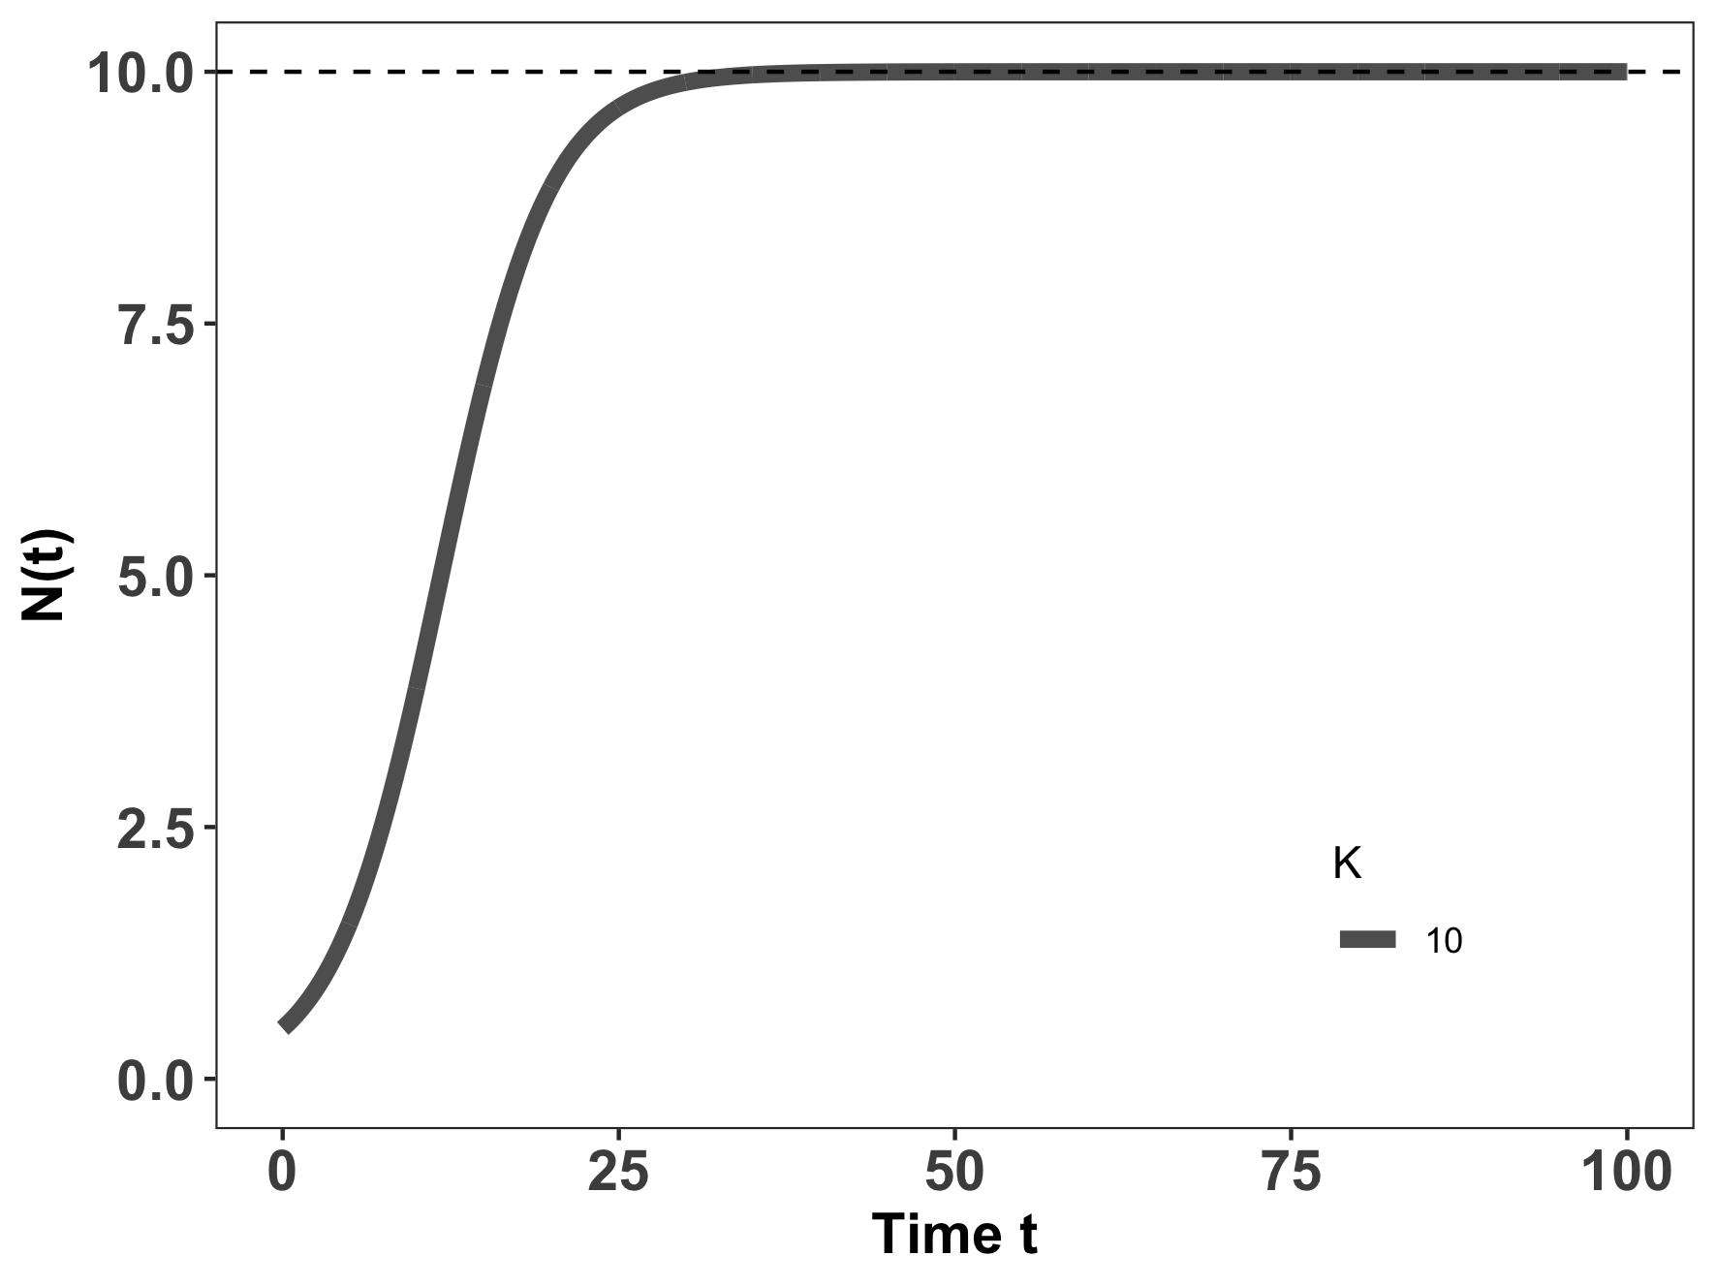
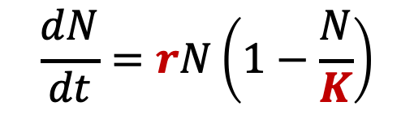
Primary succession occurs when species colonize a bare substrate.
K-selected species
r-selected species
$$\frac{dN}{dt}=rN\left(1−\frac{N}{K}\right)$$
Continuum from “r-selected” $→$ “K-selected” species.

Slide 17
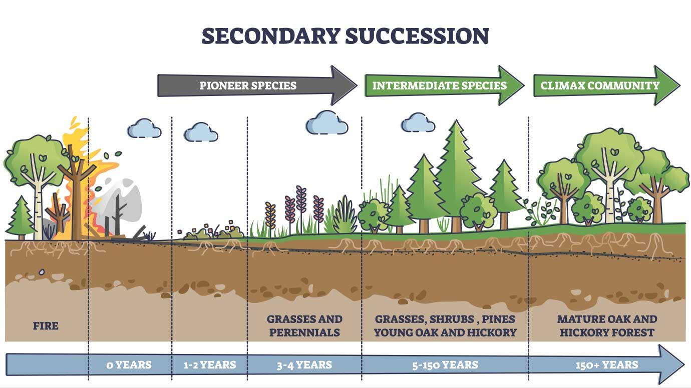
Secondary succession occurs when an environmental disturbance displaces a climax community, but soil and nutrients are still retained.

Slide 18
Secondary succession occurs when an environmental disturbance displaces a climax community, but soil and nutrients are still retained.
Continuum from “r-selected” $→$ “K-selected” species.

Slide 19
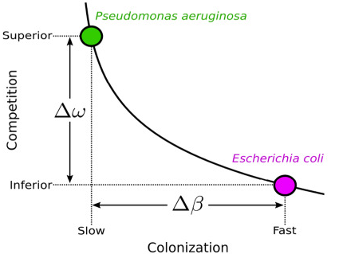
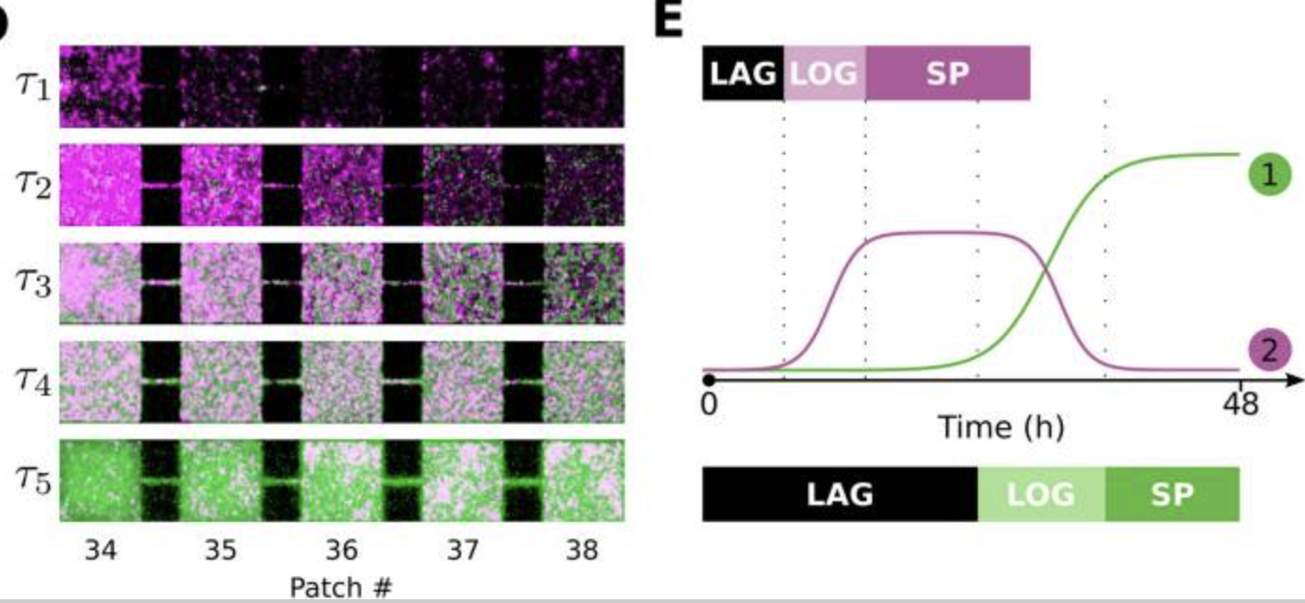
Succession also occurs in microbial systems.
Here, the “K-selected” superior competitor eventually replaces the “r-selected” fast colonizer.
Wetherington et al. 2022. BMC Biology

Slide 20
Superorganisms vs. Loose Collections of Species
Frederic Clements (1916) argued that community succession was predictable and deterministic, much like ontogenetic development in individual organisms, moving always towards some superorganism.

Slide 21
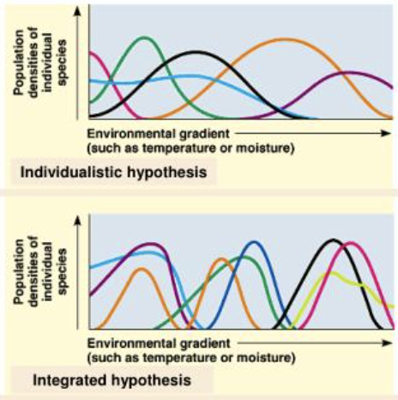
Superorganisms vs. Loose Collections of Species
Frederic Clements (1916) argued that community succession was predictable and deterministic, much like ontogenetic development in individual organisms, moving always towards some superorganism.
Priority effects: inhibitory or facilitative priority effects occur when one species ”prepares” the environment for the next species in succession

Slide 22
Superorganisms vs. Loose Collections of Species
Frederic Clements (1916) argued that community succession was predictable and deterministic, much like ontogenetic development in individual organisms, moving always towards some superorganism.
Priority effects: inhibitory or facilitative priority effects occur when one species ”prepares” the environment for the next species in succession
Henry Gleason (1926) argued instead that chance favored the dispersal of nearby species into available habitat for succession, leading to stochastic assembly of communities
Closer to Cowles’ original thinking

Slide 23
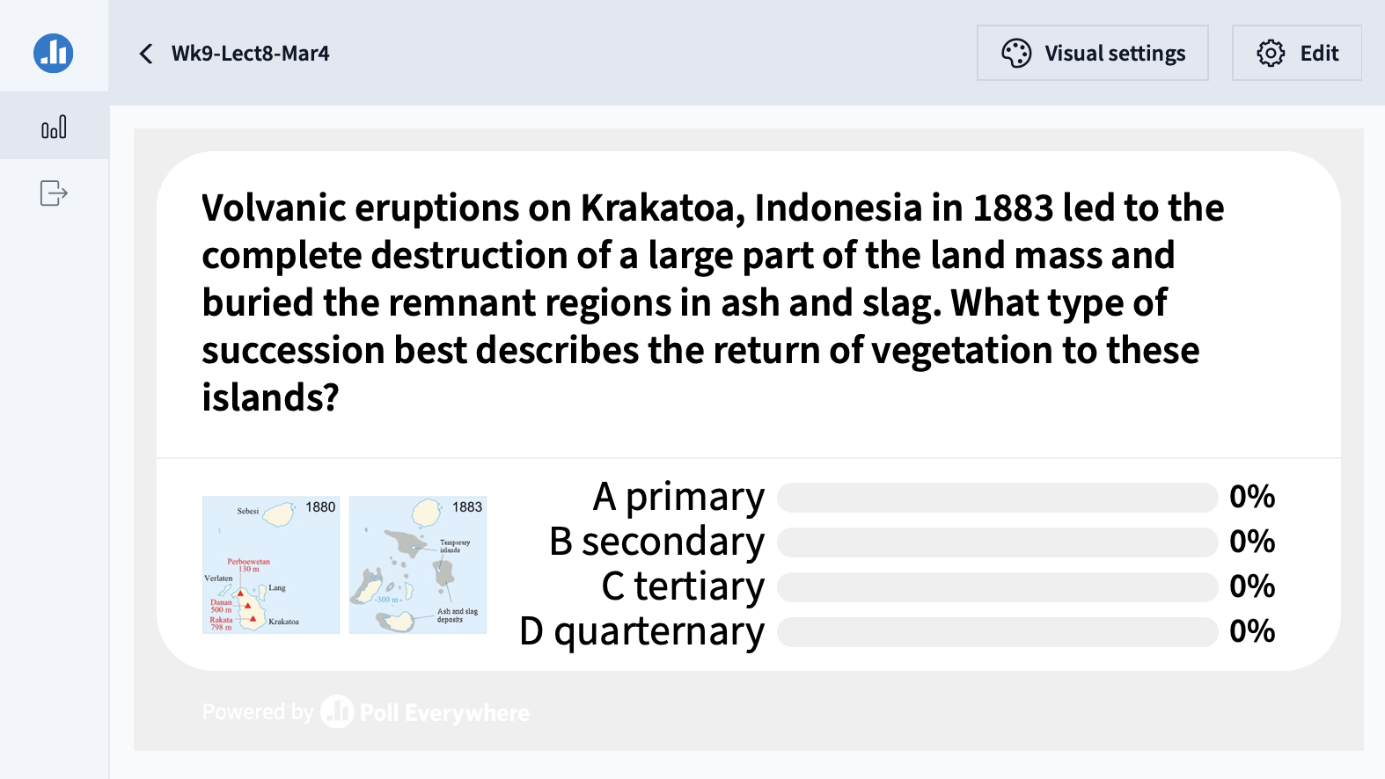

Slide 24
The field of biogeography studies the geographical distribution of plants and animals

Slide 25
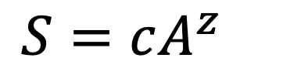
The field of biogeography studies the geographical distribution of plants and animals
Larger areas have more species!
$$S=cA^{z}$$
Preston 1964. Ecology

Slide 26
The field of biogeography studies the geographical distribution of plants and animals
Larger areas have more species!
$$S=cA^{z}$$
number of species
habitat area
Preston 1964. Ecology

Slide 27
The field of biogeography studies the geographical distribution of plants and animals
Larger areas have more species!
$$S=cA^{z}$$
slope of relationship in log-log space
number of species
habitat area
Preston 1964. Ecology

Slide 28
The field of biogeography studies the geographical distribution of plants and animals
Larger areas have more species!
$$S=cA^{z}$$
slope of relationship in log-log space
number of species
habitat area
constant based on unit of area
(standardizes to expected number of species per single unit area)
Preston 1964. Ecology

Slide 29
The field of biogeography studies the geographical distribution of plants and animals
Larger areas have more species!
The slope of the log-log relationship (z) will differ across diverse communities and ecosystems.
$$S=cA^{z}$$
Preston 1964. Ecology

Slide 30
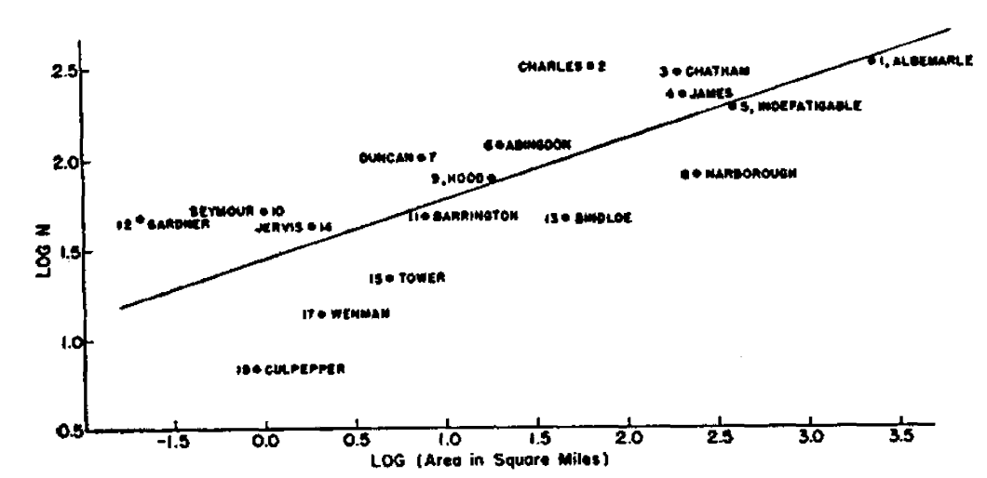
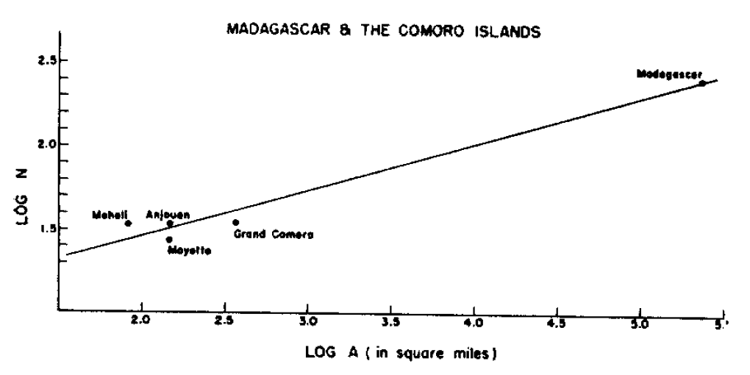
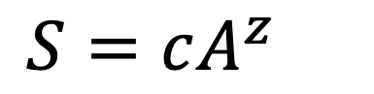
The field of biogeography studies the geographical distribution of plants and animals
Plant species of the Galapagos islands
Larger areas have more species!
The slope of the log-log relationship (z) will differ across diverse communities and ecosystems.
$$S=cA^{z}$$
Bird species of Madagascar and the Comoros
Preston 1964. Ecology

Slide 31
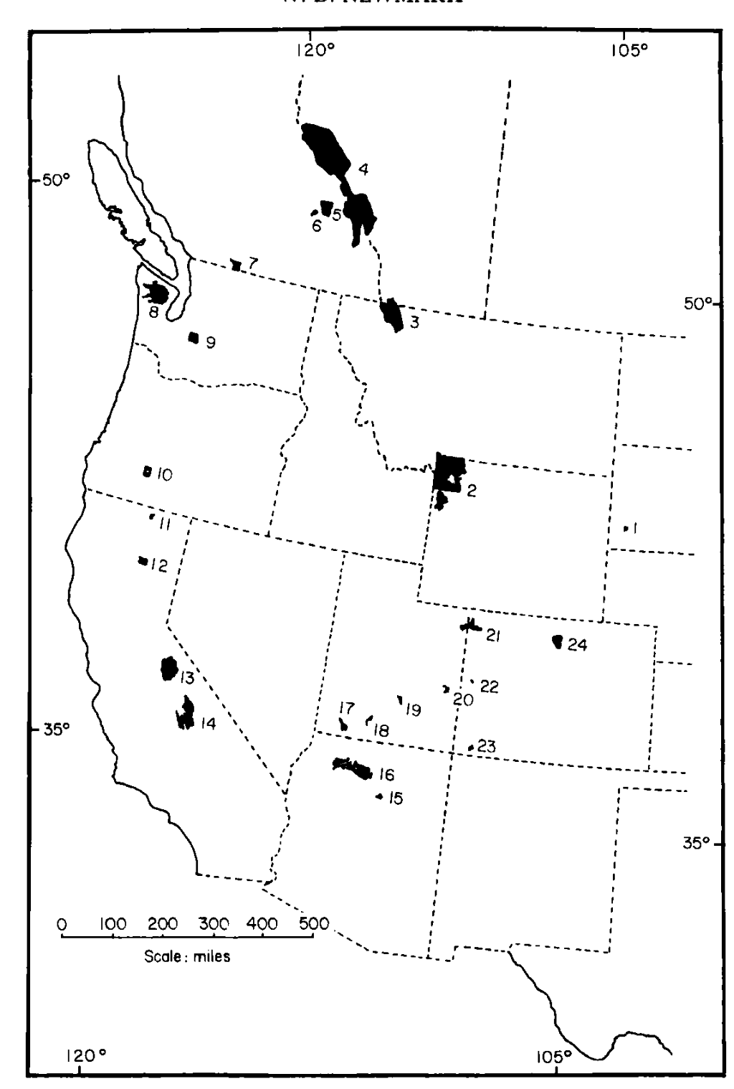
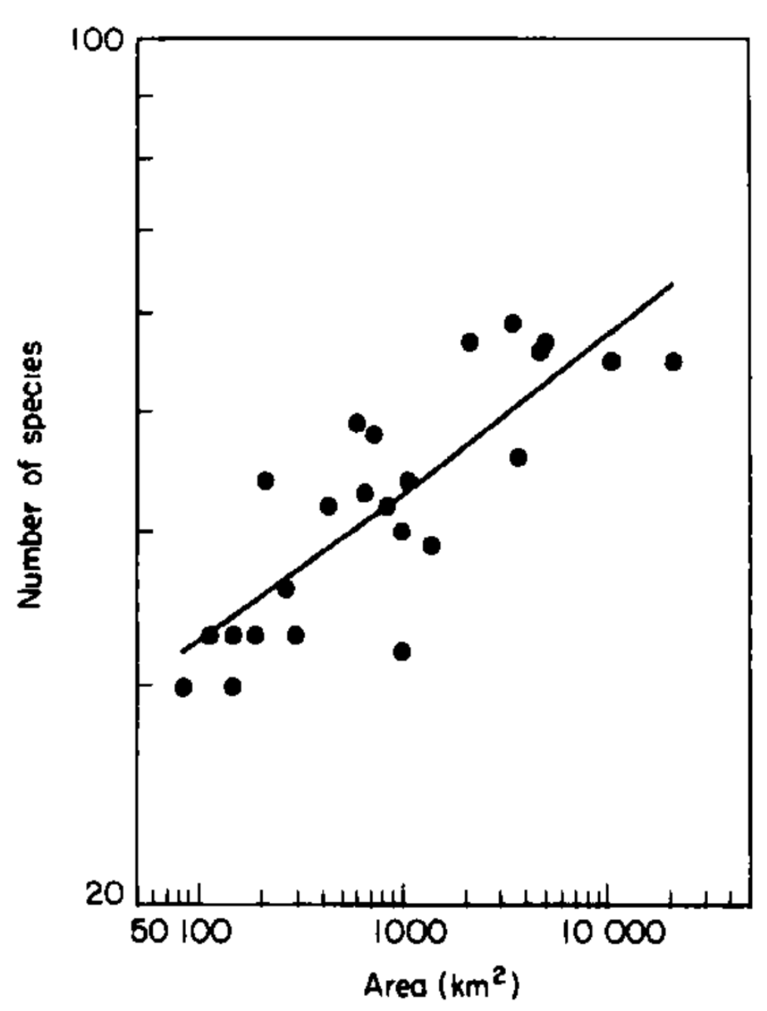
The field of biogeography studies the geographical distribution of plants and animals.
Mammal species of western US national parks
Larger areas have more species!
The slope of the log-log relationship (z) will differ across diverse communities and ecosystems.
$$S=cA^{z}$$
Newmark 1986. Biological Journal of the Linnean Society.

Slide 32
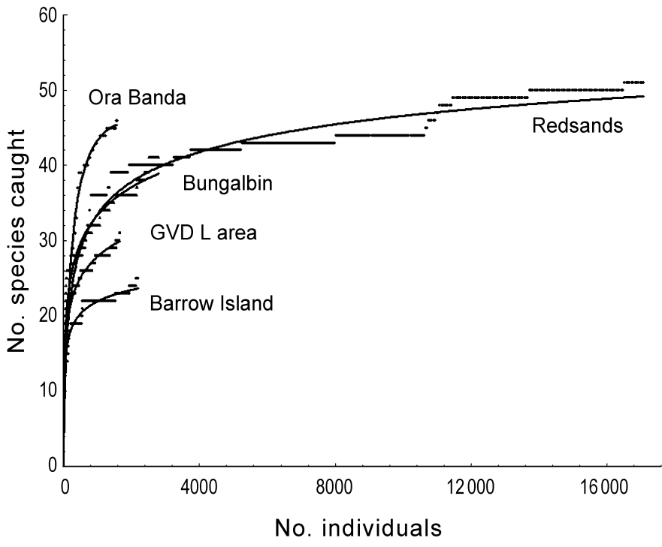
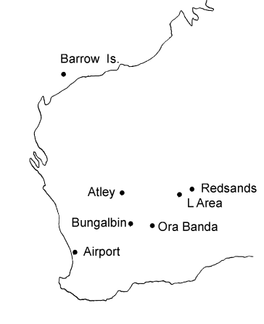
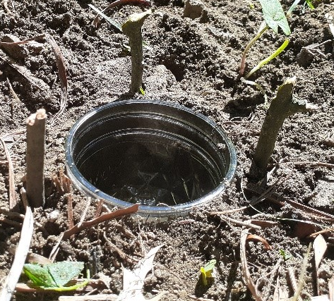
We can use the species-area relationship (SAR) to build species accumulation curves to understand if we have representatively sampled a population in field studies.
No. species captured
No. individuals captured
Thompson 2003. Animal Ecology.

Slide 33
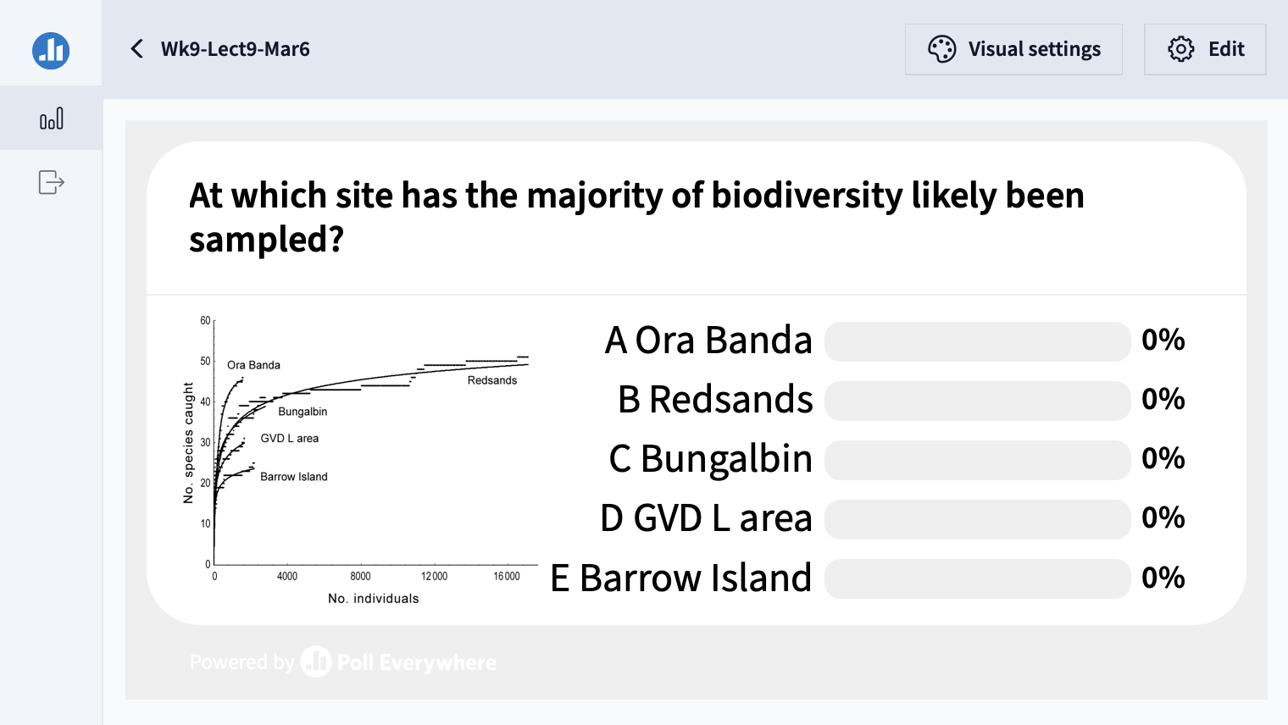

Slide 34
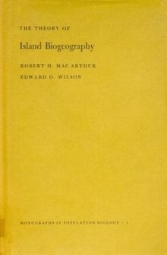
Building on the species-area relationship (SAR), MacArthur and Wilson proposed the theory of island biogeography.
MacArthur and Wilson. 1963. Evolution.
MacArthur and Wilson. 1967. The Theory of Island Biogeography.

Slide 35
Building on the species-area relationship (SAR), MacArthur and Wilson proposed the theory of island biogeography.
This theory offers a null model for the number of species found in a given habitat, predictable from both the size of the habitat and its distance from a source population.
MacArthur and Wilson. 1963. Evolution.
MacArthur and Wilson. 1967. The Theory of Island Biogeography.

Slide 36
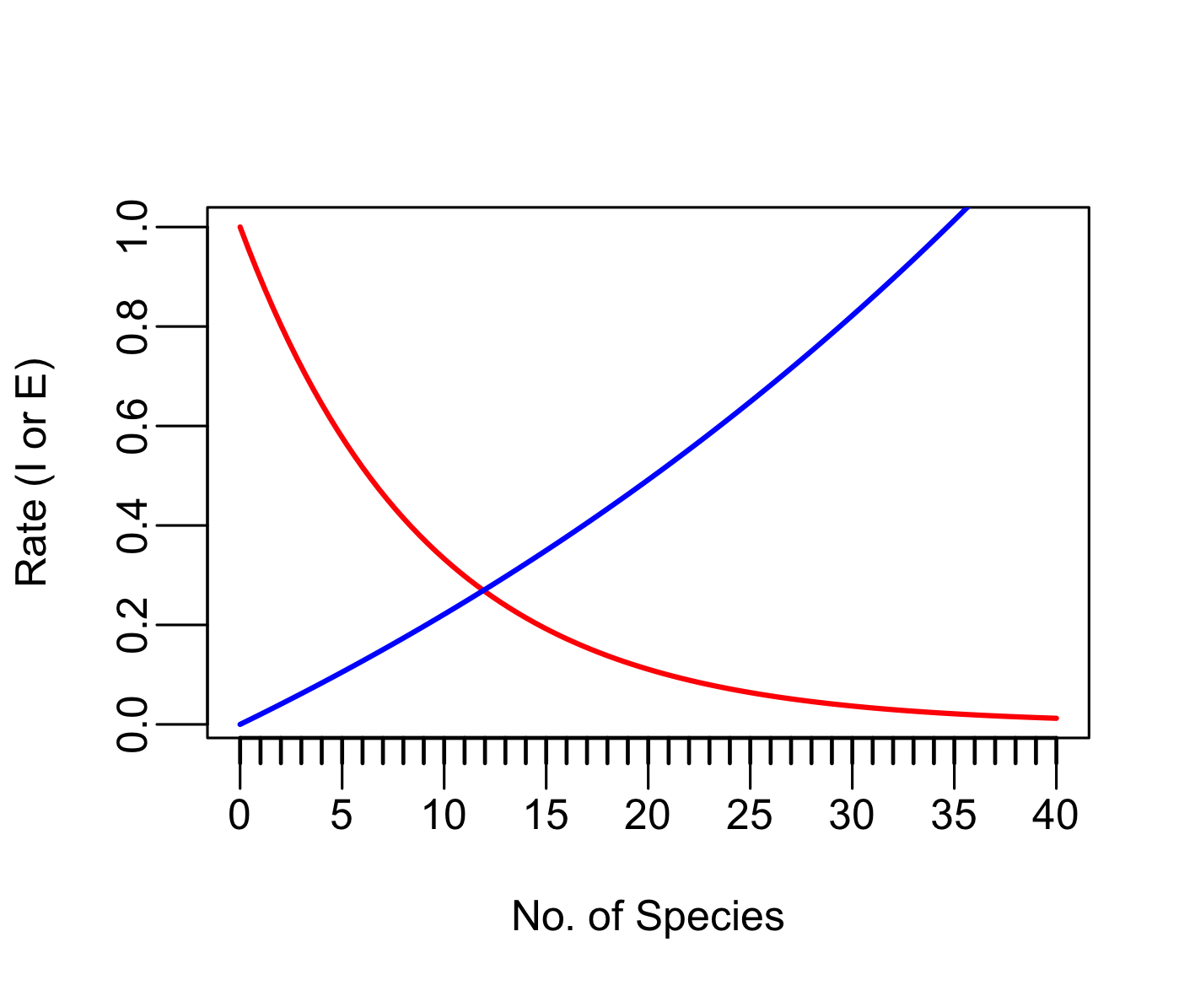
The theory of island biogeography offers a null model for the number of species found in a given habitat, predictable from both the size of the habitat and its distance from a source population.
The equilibrium number of species in
an “island” habitat is reached when:
the rate of immigration = the rate of extinction
Immigration
Extinction
MacArthur and Wilson. 1963. Evolution.
MacArthur and Wilson. 1967. The Theory of Island Biogeography.

Slide 37
Immigration rates (species arriving) are higher when the number of species is low.
Extinction rates (species leaving) are higher when the number of species is high.
The equilibrium number of species in
an “island” habitat is reached when:
the rate of immigration = the rate of extinction
Immigration
Extinction
MacArthur and Wilson. 1963. Evolution.
MacArthur and Wilson. 1967. The Theory of Island Biogeography.

Slide 38
Immigration rates (species arriving) are higher when the number of species is low.
Extinction rates (species leaving) are higher when the number of species is high.
The equilibrium number of species in
an “island” habitat is reached when:
the rate of immigration = the rate of extinction
Immigration
Extinction
Conceptually similar to Levins’ metapopulation model – and to density dependence in logistic growth!
MacArthur and Wilson. 1963. Evolution.
MacArthur and Wilson. 1967. The Theory of Island Biogeography.

Slide 39
The theory of island biogeography offers a null model for the number of species found in a given habitat, predictable from both the size of the habitat and its distance from a source population.
Distance effect: Closer islands have higher immigration rates because it’s easier for organisms to disperse across short distances.
The equilibrium number of species in
an “island” habitat is reached when:
the rate of immigration = the rate of extinction
Immigration
Extinction
MacArthur and Wilson. 1963. Evolution.
MacArthur and Wilson. 1967. The Theory of Island Biogeography.

Slide 40
The theory of island biogeography offers a null model for the number of species found in a given habitat, predictable from both the size of the habitat and its distance from a source population.
Species area-effect: Larger islands have lower extinction rates because they provide more habitat to sustain more species. Allee effects reduced at larger population sizes.
The equilibrium number of species in
an “island” habitat is reached when:
the rate of immigration = the rate of extinction
Immigration
Extinction
N=100
N=10
MacArthur and Wilson. 1963. Evolution.
MacArthur and Wilson. 1967. The Theory of Island Biogeography.

Slide 41
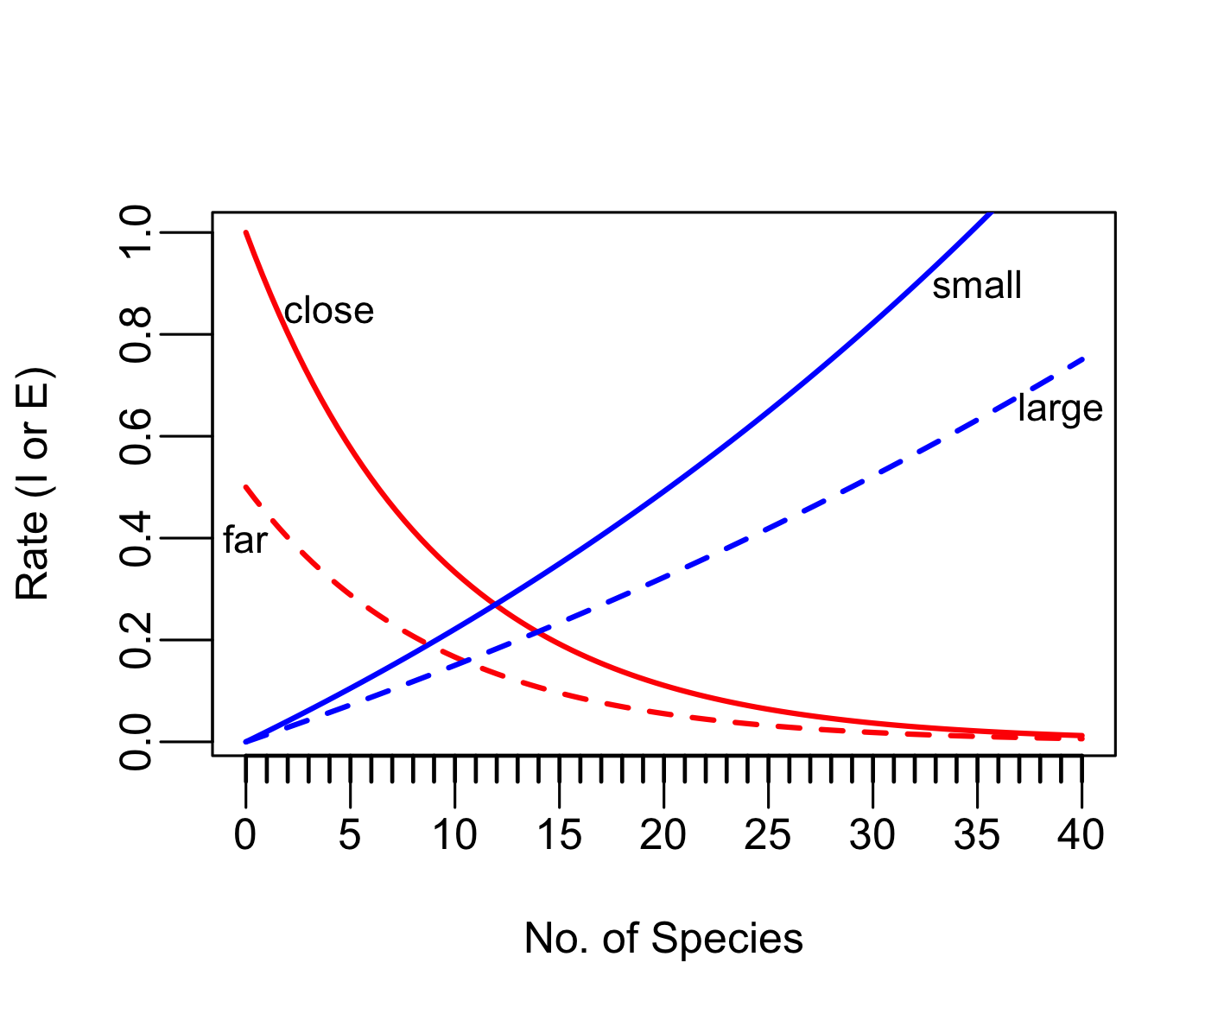
The theory of island biogeography offers a null model for the number of species found in a given habitat, predictable from both the size of the habitat and its distance from a source population.
Distance effect: Closer islands have higher immigration rates because it’s easier for organisms to disperse across short distances.
Species area-effect: Larger islands have lower extinction rates because they provide more habitat to sustain more species. Allee effects reduced at larger population sizes.
The equilibrium number of species in
an “island” habitat is reached when:
the rate of immigration = the rate of extinction
Immigration
Extinction
N=100
N=10
MacArthur and Wilson. 1963. Evolution.
MacArthur and Wilson. 1967. The Theory of Island Biogeography.

Slide 42
The theory of island biogeography offers a null model for the number of species found in a given habitat, predictable from both the size of the habitat and its distance from a source population.
Distance effect: Closer islands have higher immigration rates because it’s easier for organisms to disperse across short distances.
Species area-effect: Larger islands have lower extinction rates because they provide more habitat to sustain more species. Allee effects reduced at larger population sizes.
The equilibrium number of species in
an “island” habitat is reached when:
the rate of immigration = the rate of extinction
Immigration
Extinction
turnover rate for far-small
S*: far-small
MacArthur and Wilson. 1963. Evolution.
MacArthur and Wilson. 1967. The Theory of Island Biogeography.

Slide 43
The theory of island biogeography offers a null model for the number of species found in a given habitat, predictable from both the size of the habitat and its distance from a source population.
Distance effect: Closer islands have higher immigration rates because it’s easier for organisms to disperse across short distances.
Species area-effect: Larger islands have lower extinction rates because they provide more habitat to sustain more species. Allee effects reduced at larger population sizes.
The equilibrium number of species in
an “island” habitat is reached when:
the rate of immigration = the rate of extinction
Immigration
Extinction
S*: far-small
S*: close-large
S*: far-large
S*: close-small

Slide 44
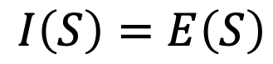
The theory of island biogeography offers a null model for the number of species found in a given habitat, predictable from both the size of the habitat and its distance from a source population.
Distance effect: Closer islands have higher immigration rates because it’s easier for organisms to disperse across short distances.
The equilibrium number of species in
an “island” habitat is reached when:
the rate of immigration = the rate of extinction
Species area-effect: Larger islands have lower extinction rates because they provide more habitat to sustain more species. Allee effects reduced at larger population sizes.
$$I\left(S\right)=E\left(S\right)$$
Immigration
Extinction

Slide 45
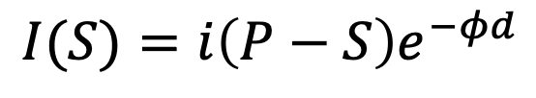
The theory of island biogeography offers a null model for the number of species found in a given habitat, predictable from both the size of the habitat and its distance from a source population.
Distance effect: Closer islands have higher immigration rates because it’s easier for organisms to disperse across short distances.
The equilibrium number of species in
an “island” habitat is reached when:
the rate of immigration = the rate of extinction
Species area-effect: Larger islands have lower extinction rates because they provide more habitat to sustain more species. Allee effects reduced at larger population sizes.
$$I\left(S\right)=E\left(S\right)$$
$$I(S)={i\left(P−S\right)e}^{−φd}$$
Immigration
Extinction
distance from island to source population
immigration rate
number of species on island
total number of species in pool
fit parameter governing distance decay on immigration rate

Slide 46
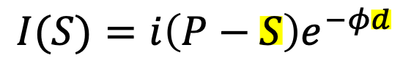
The theory of island biogeography offers a null model for the number of species found in a given habitat, predictable from both the size of the habitat and its distance from a source population.
Distance effect: Closer islands have higher immigration rates because it’s easier for organisms to disperse across short distances.
The equilibrium number of species in
an “island” habitat is reached when:
the rate of immigration = the rate of extinction
Species area-effect: Larger islands have lower extinction rates because they provide more habitat to sustain more species. Allee effects reduced at larger population sizes.
$$I\left(S\right)=E\left(S\right)$$
$$I(S)={i\left(P−S\right)e}^{−φd}$$
Immigration
Extinction
distance from island to source population
immigration rate
number of species on island
total number of species in pool
fit parameter governing distance decay on immigration rate
Immigration is highest when species number is lowest and distance is smallest!

Slide 47
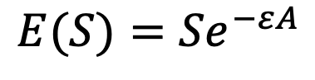
The theory of island biogeography offers a null model for the number of species found in a given habitat, predictable from both the size of the habitat and its distance from a source population.
Distance effect: Closer islands have higher immigration rates because it’s easier for organisms to disperse across short distances.
The equilibrium number of species in
an “island” habitat is reached when:
the rate of immigration = the rate of extinction
Species area-effect: Larger islands have lower extinction rates because they provide more habitat to sustain more species. Allee effects reduced at larger population sizes.
$$I\left(S\right)=E\left(S\right)$$
Immigration
Extinction
$$E(S)={Se}^{−εA}$$
fit parameter scaling effect of area on extinction
area of habitat
number of species on island

Slide 48
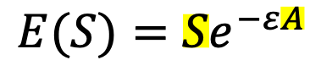
The theory of island biogeography offers a null model for the number of species found in a given habitat, predictable from both the size of the habitat and its distance from a source population.
Distance effect: Closer islands have higher immigration rates because it’s easier for organisms to disperse across short distances.
The equilibrium number of species in
an “island” habitat is reached when:
the rate of immigration = the rate of extinction
Species area-effect: Larger islands have lower extinction rates because they provide more habitat to sustain more species. Allee effects reduced at larger population sizes.
$$I\left(S\right)=E\left(S\right)$$
Immigration
Extinction
$$E(S)={Se}^{−εA}$$
fit parameter scaling effect of area on extinction
area of habitat
number of species on island
Extinction is highest when species number is highest and area is smallest!

Slide 49
The theory of island biogeography offers a null model for the number of species found in a given habitat, predictable from both the size of the habitat and its distance from a source population.
Distance effect: Closer islands have higher immigration rates because it’s easier for organisms to disperse across short distances.
The equilibrium number of species in
an “island” habitat is reached when:
the rate of immigration = the rate of extinction
Species area-effect: Larger islands have lower extinction rates because they provide more habitat to sustain more species. Allee effects reduced at larger population sizes.
$$I\left(S\right)=E\left(S\right)$$
$$I(S)={i\left(P−S\right)e}^{−φd}$$
Immigration
Extinction
$$E(S)={Se}^{−εA}$$
distance from island to source population
immigration rate
number of species on island
area of habitat
number of species on island
fit parameter scaling effect of area on extinction
total number of species in pool
fit parameter governing distance decay on immigration rate

Slide 50
The theory of island biogeography offers a null model for the number of species found in a given habitat, predictable from both the size of the habitat and its distance from a source population.
Distance effect: Closer islands have higher immigration rates because it’s easier for organisms to disperse across short distances.
The equilibrium number of species in
an “island” habitat is reached when:
the rate of immigration = the rate of extinction
Species area-effect: Larger islands have lower extinction rates because they provide more habitat to sustain more species. Allee effects reduced at larger population sizes.
$$I\left(S\right)=E\left(S\right)$$
$$I(S)={i\left(P−S\right)e}^{−φd}$$
Immigration
Extinction
$$E(S)={Se}^{−εA}$$
distance from island to source population
immigration rate
number of species on island
area of habitat
number of species on island
fit parameter scaling effect of area on extinction
total number of species in pool
fit parameter governing distance decay on immigration rate

Slide 51
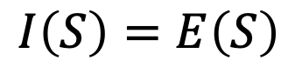
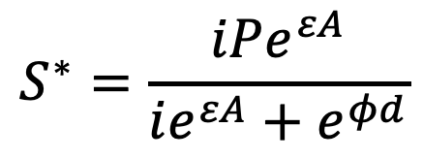
The theory of island biogeography offers a null model for the number of species found in a given habitat, predictable from both the size of the habitat and its distance from a source population.
The equilibrium number of species in
an “island” habitat is reached when:
the rate of immigration = the rate of extinction
$$I\left(S\right)=E\left(S\right)$$
Immigration
Extinction
$$S^{∗}=\frac{iPe^{εA}}{ie^{εA}+e^{φd}}$$
MacArthur and Wilson. 1963. Evolution.
MacArthur and Wilson. 1967. The Theory of Island Biogeography.

Slide 52
The theory of island biogeography offers a null model for the number of species found in a given habitat, predictable from both the size of the habitat and its distance from a source population.
The equilibrium number of species in
an “island” habitat is reached when:
the rate of immigration = the rate of extinction
increases with number of species in source pool
increases with area of island
Immigration
Extinction
$$S^{∗}=\frac{iPe^{εA}}{ie^{εA}+e^{φd}}$$
decreases with distance from with distance from mainland
equilibrium number of species
MacArthur and Wilson. 1963. Evolution.
MacArthur and Wilson. 1967. The Theory of Island Biogeography.

Slide 53
Extensions to the theory of island biogeography…
Species area-effect: Larger islands have lower extinction rates because they provide more habitat to sustain more species. Allee effects reduced at larger population sizes.
Distance effect: Closer islands have higher immigration rates because it’s easier for organisms to disperse across short distances.
The equilibrium number of species in
an “island” habitat is reached when:
the rate of immigration = the rate of extinction
Immigration
Extinction
N=100
N=10

Slide 54
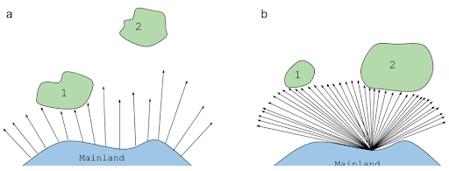
Extensions to the theory of island biogeography…
Species area-effect: Larger islands have lower extinction rates because they provide more habitat to sustain more species. Allee effects reduced at larger population sizes.
Distance effect: Closer islands have higher immigration rates because it’s easier for organisms to disperse across short distances.
The equilibrium number of species in
an “island” habitat is reached when:
the rate of immigration = the rate of extinction
Immigration
Target effect: larger islands have higher immigration rates because they offer a bigger target to land on!
Extinction
Rescue effect: Closer islands have lower extinction rates because they can be repopulated from the mainland!

Slide 55
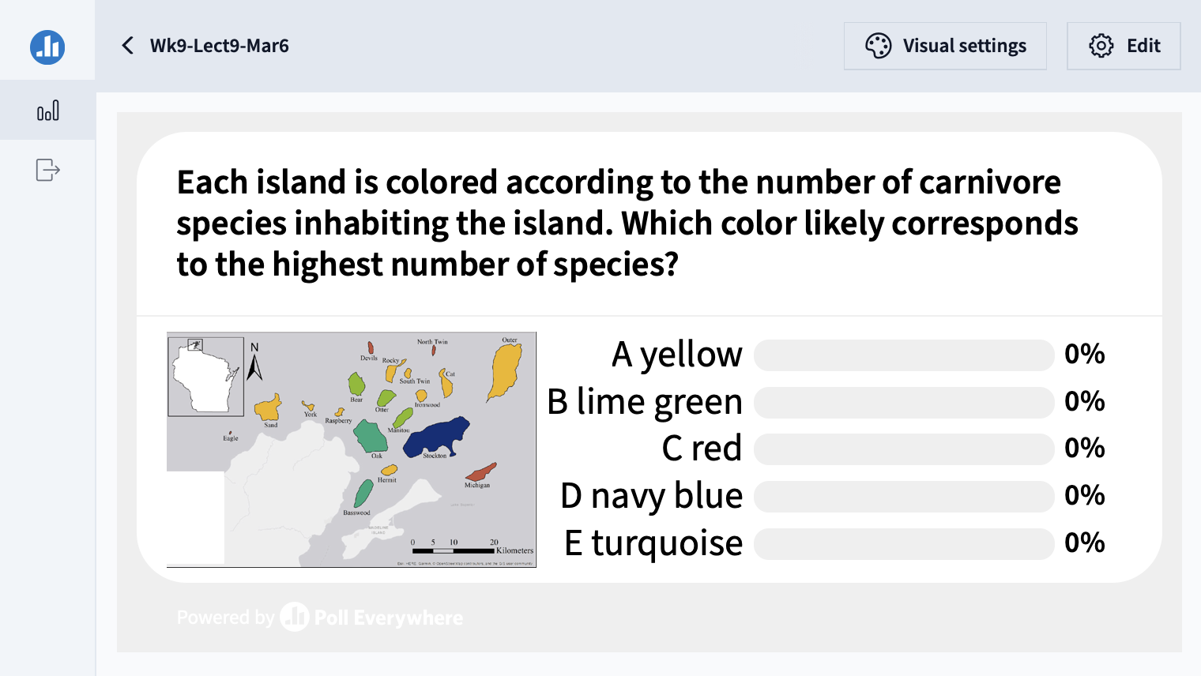

Slide 56
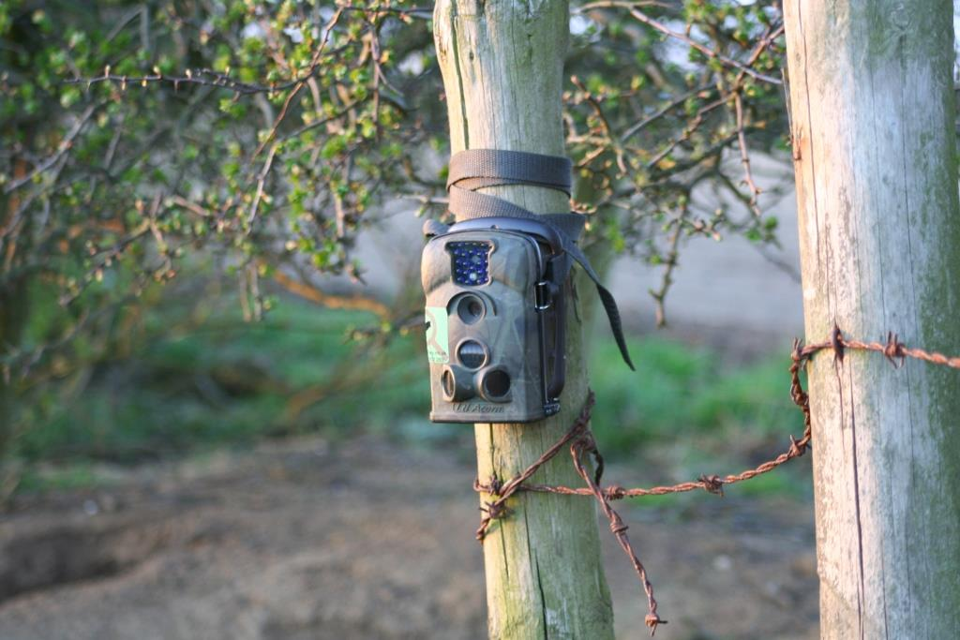
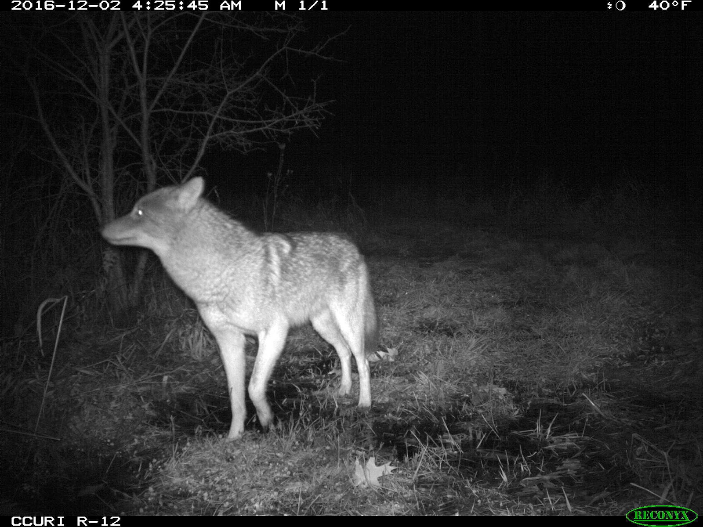
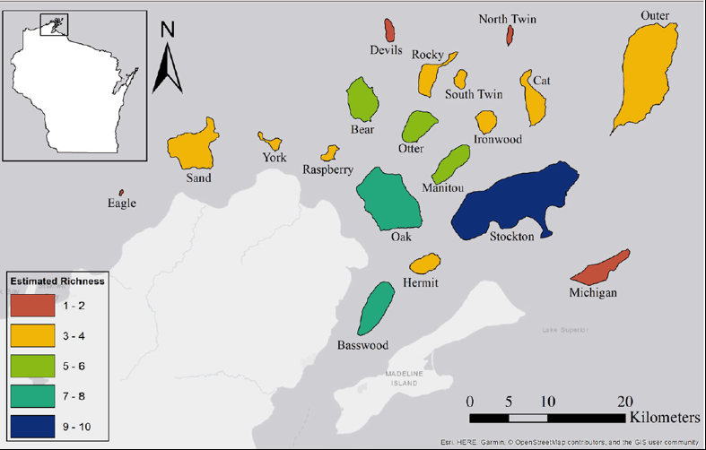
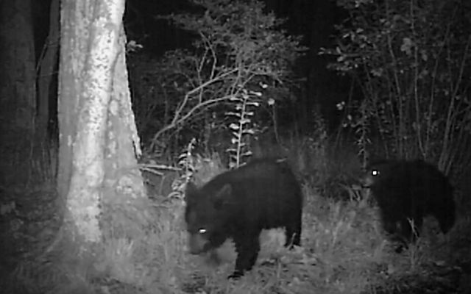
The importance of island size vs. distance varied for different species!
Coyote
American Black Bear
Allen et al. 2018. Community Ecology.

Slide 57
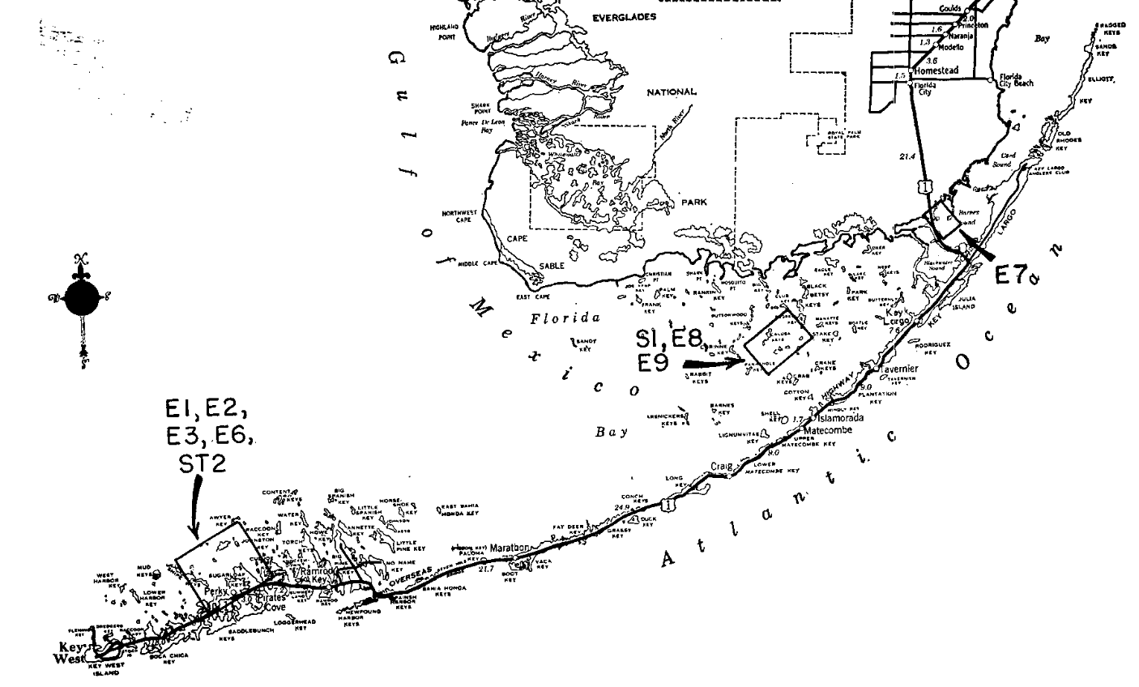
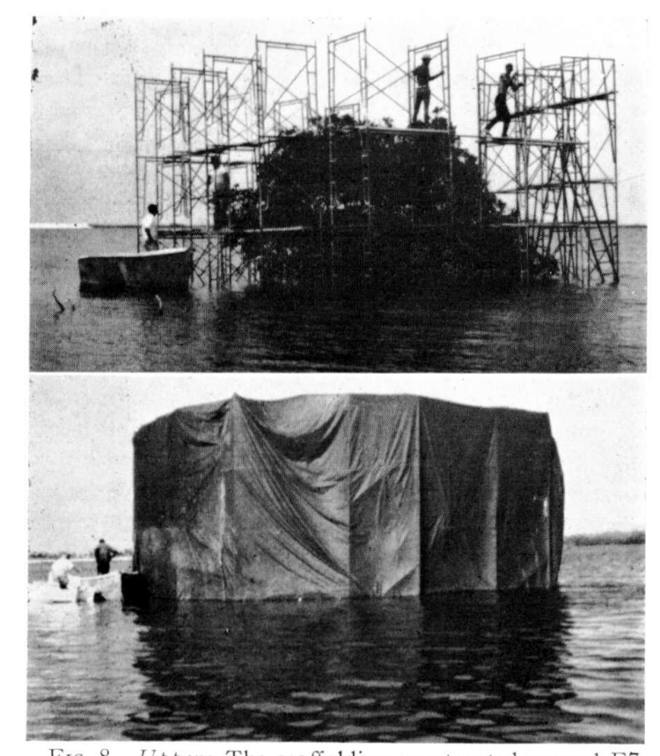
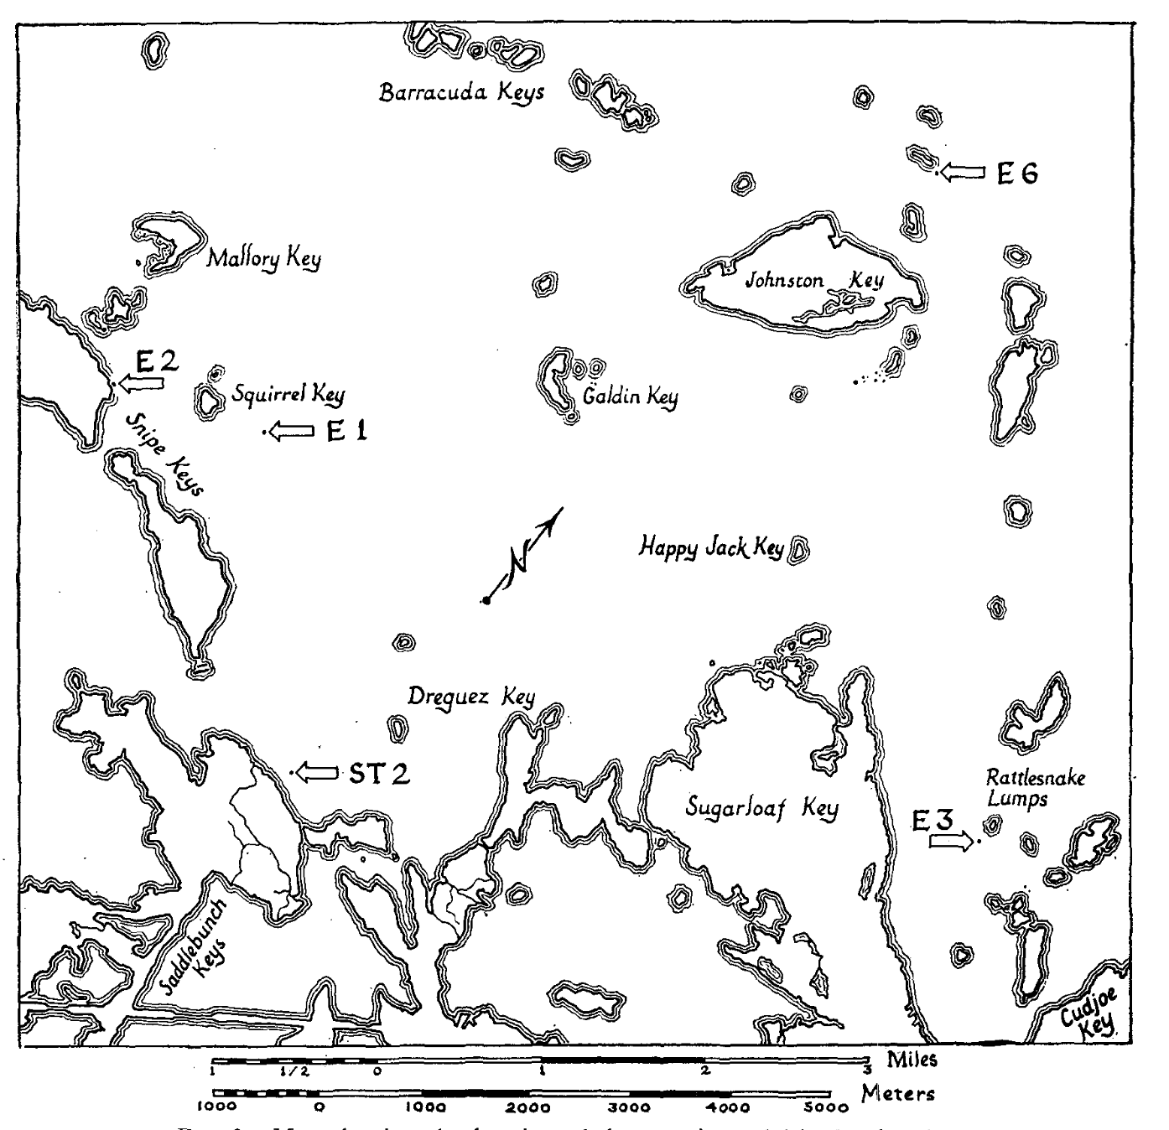
Wilson and Simberloff field-tested island biogeography theory in the Florida Keys!
Wilson and Simberloff identified seven mangrove islands in the Florida Keys varying in size from 11-18m in diameter and catalogued their fauna (all arthropods).
They also conducted surveys across the keys to quantify the entire possible “source” pool to the islands.
The experimental islands were then fumigated with methyl bromide at levels lethal to arthropods but not to plants.
They catalogued their progressive recolonization after fumigation, tracking its predictability based on size and distance of these islands to the source pool.
Simberloff. 1969. Ecology.
Wilson and Simberloff. 1969. Ecology.
Simberloff and Wilson. 1969. Ecology.

Slide 58
Wilson and Simberloff field-tested island biogeography theory in the Florida Keys!
Wilson and Simberloff identified seven mangrove islands in the Florida Keys varying in size from 11-18m in diameter and catalogued their fauna (all arthropods).
They also conducted surveys across the keys to quantify the entire possible “source” pool to the islands.
The experimental islands were then fumigated with methyl bromide at levels lethal to arthropods but not to plants.
They catalogued their progressive recolonization after fumigation, tracking its predictability based on size and distance of these islands to the source pool.
Simberloff. 1969. Ecology.
Wilson and Simberloff. 1969. Ecology.
Simberloff and Wilson. 1969. Ecology.

Slide 59
Wilson and Simberloff field-tested island biogeography theory in the Florida Keys!
Wilson and Simberloff identified seven mangrove islands in the Florida Keys varying in size from 11-18m in diameter and catalogued their fauna (all arthropods).
They also conducted surveys across the keys to quantify the entire possible “source” pool to the islands.
The experimental islands were then fumigated with methyl bromide at levels lethal to arthropods but not to plants.
They catalogued their progressive recolonization after fumigation, tracking its predictability based on size and distance of these islands to the source pool.
Simberloff. 1969. Ecology.
Wilson and Simberloff. 1969. Ecology.
Simberloff and Wilson. 1969. Ecology.

Slide 60
Wilson and Simberloff field-tested island biogeography theory in the Florida Keys!
Wilson and Simberloff identified seven mangrove islands in the Florida Keys varying in size from 11-18m in diameter and catalogued their fauna (all arthropods).
They also conducted surveys across the keys to quantify the entire possible “source” pool to the islands.
The experimental islands were then fumigated with methyl bromide at levels lethal to arthropods but not to plants.
They catalogued their progressive recolonization after fumigation, tracking its predictability based on size and distance of these islands to the source pool.
Simberloff. 1969. Ecology.
Wilson and Simberloff. 1969. Ecology.
Simberloff and Wilson. 1969. Ecology.

Slide 61
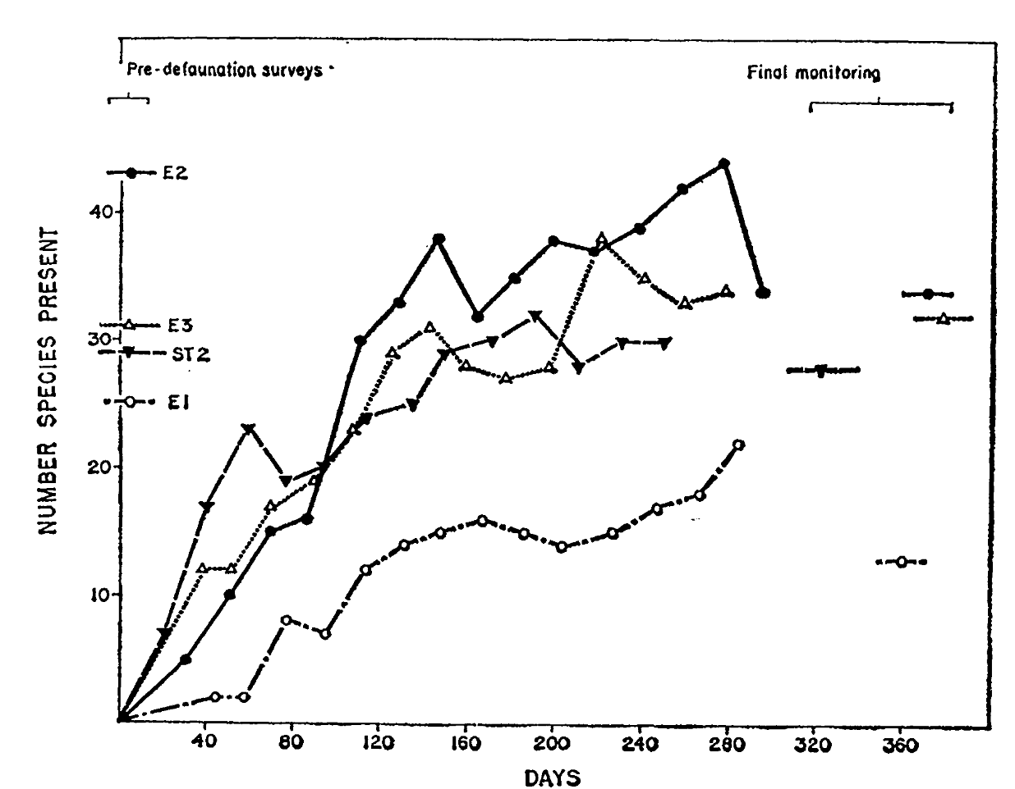
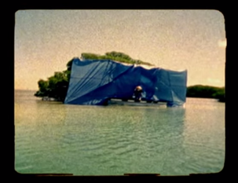
Wilson and Simberloff field-tested island biogeography theory in the Florida Keys!
Islands were recolonized to pre-defaunation levels rapidly, within a year!
Though the equilibrium number of species was the same, the identity was quite different – only about 40% similar to the original censuses.
Strong flyers recolonized first but were eventually replaced (outcompeted) by better competitors (typically ants) – in keeping with theories of faunal succession.
The islands farthest from the mainland were the slowest to recolonize.
Simberloff. 1969. Ecology.
Wilson and Simberloff. 1969. Ecology.
Simberloff and Wilson. 1969. Ecology.

Slide 62
Wilson and Simberloff field-tested island biogeography theory in the Florida Keys!
Islands were recolonized to pre-defaunation levels rapidly, within a year!
Though the equilibrium number of species was the same, the identity was quite different – only about 40% similar to the original censuses.
Strong flyers recolonized first but were eventually replaced (outcompeted) by better competitors (typically ants) – in keeping with theories of faunal succession.
The islands farthest from the mainland were the slowest to recolonize.
Simberloff. 1969. Ecology.
Wilson and Simberloff. 1969. Ecology.
Simberloff and Wilson. 1969. Ecology.

Slide 63
Wilson and Simberloff field-tested island biogeography theory in the Florida Keys!
Islands were recolonized to pre-defaunation levels rapidly, within a year!
Though the equilibrium number of species was the same, the identity was quite different – only about 40% similar to the original censuses.
Strong flyers recolonized first but were eventually replaced (outcompeted) by better competitors (typically ants) – in keeping with theories of faunal succession.
The islands farthest from the mainland were the slowest to recolonize.
Simberloff. 1969. Ecology.
Wilson and Simberloff. 1969. Ecology.
Simberloff and Wilson. 1969. Ecology.

Slide 64
Wilson and Simberloff field-tested island biogeography theory in the Florida Keys!
Islands were recolonized to pre-defaunation levels rapidly, within a year!
Though the equilibrium number of species was the same, the identity was quite different – only about 40% similar to the original censuses.
Strong flyers recolonized first but were eventually replaced (outcompeted) by better competitors (typically ants) – in keeping with theories of faunal succession.
The islands farthest from the mainland were the slowest to recolonize.
Simberloff. 1969. Ecology.
Wilson and Simberloff. 1969. Ecology.
Simberloff and Wilson. 1969. Ecology.

Slide 65
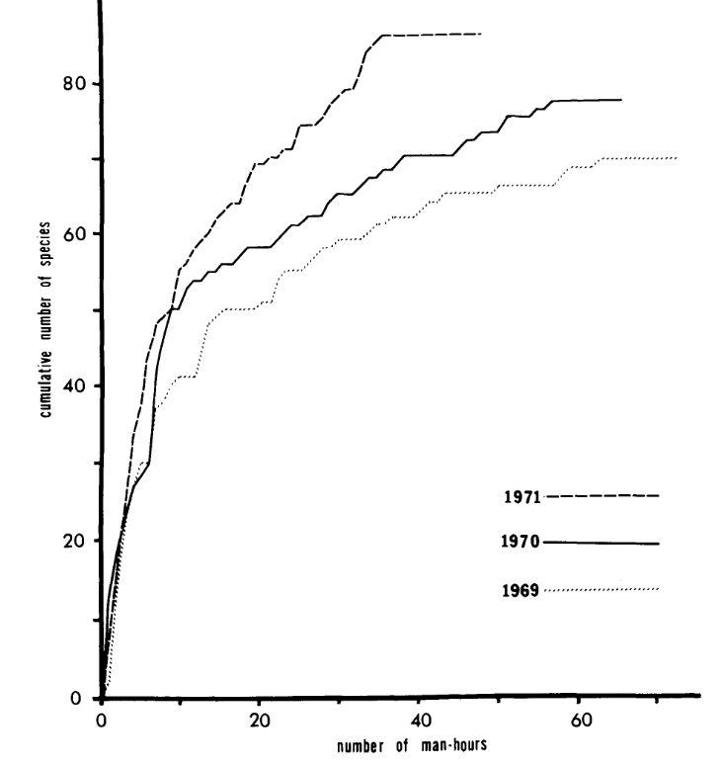
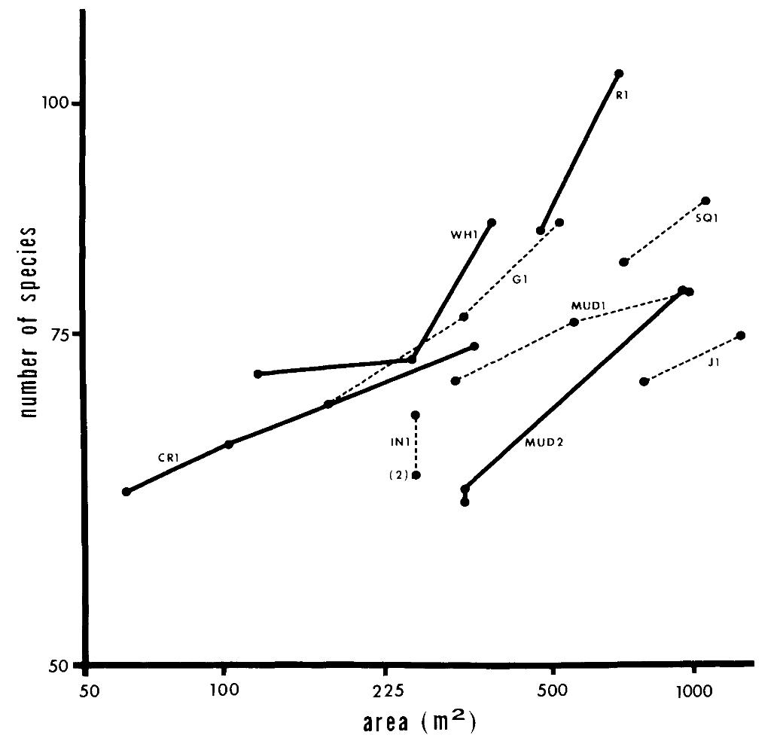

In subsequent work, Simberloff demonstrated the area effect by actually removing entire chunks out of islands and censusing species!
log-log plot of island area and species count before and after land removal!
Pre-land removal species accumulation curves demonstrate that a sufficient quantity of biodiversity was sampled.
Simberloff. 1976. Ecology.

Slide 66
Superorganisms vs. Loose Collections of Species?
Frederic Clements (1916) argued that community succession was predictable and deterministic, much like ontogenetic development in individual organisms, moving always towards some superorganism.
Priority effects: inhibitory or facilitative priority effects occur when one species ”prepares” the environment for the next species in succession
Henry Gleason (1926) argued instead that chance favored the dispersal of nearby species into available habitat for succession, leading to stochastic assembly of communities
Closer to Cowles’ original thinking

Slide 67



Niche-based assembly vs. Neutral theories of assembly?
Niche: match of a species to specific environmental conditions
Assembly will be deterministic
Joseph Grinnell (1917) – coined the term for the CA thrasher and its chapparal habitat. Includes physical match and behavioral adaptations
Neutral: species-specific differences within a trophic level will be irrelevant to their success
Assembly will be stochastic
MacArthur and Wilson 1967
Hubbell (2001) - Unified neutral theory of biodiversity and biogeography (UNTB)

Slide 68


Island biogeography has greatly influenced the design of protected area reserves
Area effect:
Island size and resident, non-marine bird species number near New Guinea
Distance effect:
Island resident, non-marine bird species count by distance from New Guinea (standardized by area)
Diamond. 1975. Biological Conservation.

Slide 69



Island biogeography has greatly influenced the design of protected area reserves
Mammalian extirpations post-establishment by area size in western North American national parks
“SLOSS” debate
(1970s-1980s)
Reserve design estimated to protect the largest number of species based on island biogeography theory
Newmark. 1987. Nature.
Diamond. 1975. Biological Conservation.

Slide 70
Population Biology
Conservation Biology
Disease Ecology
Goal:
protect populations from extinction
Concept:
Minimum Viable Population size (MVP)
Approach:
protected area reserves
Goal:
protect populations from disease via pathogen extinction
Concept:
Critical Community Size (CCS)
Approach:
sanitation
vaccination

Slide 71
Population Biology
Conservation Biology
Disease Ecology
Goal:
protect populations from extinction
Concept:
Minimum Viable Population size (MVP)
Approach:
protected area reserves
Goal:
protect populations from disease via pathogen extinction
Concept:
Critical Community Size (CCS)
Approach:
sanitation
vaccination
MVP = the minimum number of individuals in a population needed to sustain the population 1000 years into the future
CCS = the minimum number of hosts needed to sustain endemic transmission of a pathogen indefinitely into the future

Slide 72
Population Biology
Conservation Biology
Disease Ecology
Goal:
protect populations from extinction
Concept:
Minimum Viable Population size (MVP)
Approach:
protected area reserves
Goal:
protect populations from disease via pathogen extinction
Concept:
Critical Community Size (CCS)
Approach:
sanitation
vaccination

Slide 73
Biodiversity can be measured in several ways!

Slide 74
Biodiversity can be measured in several ways!
Landscape A
Site 1
Site 2
Whittaker. 1960. Ecological Monographs.

Slide 75

Biodiversity can be measured in several ways!
(here = 3)
$α$ – diversity = species richness, typically within a small specified region
Landscape A
Site 1
Site 2
(here = 4)
Whittaker. 1960. Ecological Monographs.

Slide 76

Biodiversity can be measured in several ways!
(here = 3)
$α$ – diversity = species richness, typically within a small specified region
Landscape A
Site 1
$γ$ – diversity = total species diversity in the landscape (here = 5)
Site 2
(here = 4)
Whittaker. 1960. Ecological Monographs.

Slide 77


Biodiversity can be measured in several ways!
(here = 3)
(here = 1.67 or 2)
$α$ – diversity = species richness, typically within a small specified region
Landscape A
Site 1
$γ$ – diversity = total species diversity in the landscape (here = 5)
Site 2
(here = 1.25 or 1)
$β$– diversity = ratio between landscape and local species diversity, either $\left(\frac{γ}{α}\right)$ or $\left(γ\text{−}α\right)$
Site 1 has lower $α$– diversity but higher $β$– diversity than site 2. Both are important!
(here = 4)
Whittaker. 1960. Ecological Monographs.

Slide 78

Biodiversity is concentrated in the tropics.
(terrestrial vertebrate diversity)
Mannion. 2014. Trends in Ecology & Evolution.

Slide 79
Biodiversity is concentrated in the tropics.
We still lack a satisfying model to explain why.
(terrestrial vertebrate diversity)
Mannion. 2014. Trends in Ecology & Evolution.

Slide 80
Biodiversity is concentrated in the tropics.
We still lack a satisfying model to explain why.
Some candidate hypotheses:
Geographical area hypothesis. More area in the tropics = more species… but there’s just as much area north of the tropics and fewer species!
Species-energy hypothesis. Increased solar energy at low latitudes causes increased net primary productivity (or photosynthesis) and drives accumulation of species up the food web…but offers a better prediction for abundance and biomass than for numbers of species.
Historical perturbation hypothesis. Polar regions have not yet recovered equilibrium species numbers after glaciation… but does not hold for marine systems, where the latitudinal gradient still exists…
Biotic interactions hypothesis. More species yield more species as processes of competition, predation, etc. are intensified in the tropics… but cannot provide the basal cause for the accumulation of more species to begin with!
Mannion. 2014. Trends in Ecology & Evolution.

Slide 81
Biodiversity is concentrated in the tropics.
We still lack a satisfying model to explain why.
Some candidate hypotheses:
Geographical area hypothesis. More area in the tropics = more species… but there’s just as much area north of the tropics and fewer species!
Species-energy hypothesis. Increased solar energy at low latitudes causes increased net primary productivity (or photosynthesis) and drives accumulation of species up the food web…but offers a better prediction for abundance and biomass than for numbers of species.
Historical perturbation hypothesis. Polar regions have not yet recovered equilibrium species numbers after glaciation… but does not hold for marine systems, where the latitudinal gradient still exists…
Biotic interactions hypothesis. More species yield more species as processes of competition, predation, etc. are intensified in the tropics… but cannot provide the basal cause for the accumulation of more species to begin with!
Mannion. 2014. Trends in Ecology & Evolution.

Slide 82
Biodiversity is concentrated in the tropics.
We still lack a satisfying model to explain why.
Some candidate hypotheses:
Geographical area hypothesis. More area in the tropics = more species… but there’s just as much area north of the tropics and fewer species!
Species-energy hypothesis. Increased solar energy at low latitudes causes increased net primary productivity (or photosynthesis) and drives accumulation of species up the food web…but offers a better prediction for abundance and biomass than for numbers of species.
Historical perturbation hypothesis. Polar regions have not yet recovered equilibrium species numbers after glaciation… but does not hold for marine systems, where the latitudinal gradient still exists…
Biotic interactions hypothesis. More species yield more species as processes of competition, predation, etc. are intensified in the tropics… but cannot provide the basal cause for the accumulation of more species to begin with!
Mannion. 2014. Trends in Ecology & Evolution.

Slide 83
Biodiversity is concentrated in the tropics.
We still lack a satisfying model to explain why.
Some candidate hypotheses:
Geographical area hypothesis. More area in the tropics = more species… but there’s just as much area north of the tropics and fewer species!
Species-energy hypothesis. Increased solar energy at low latitudes causes increased net primary productivity (or photosynthesis) and drives accumulation of species up the food web…but offers a better prediction for abundance and biomass than for numbers of species.
Historical perturbation hypothesis. Polar regions have not yet recovered equilibrium species numbers after glaciation… but does not hold for marine systems, where the latitudinal gradient still exists…
Biotic interactions hypothesis. More species yield more species as processes of competition, predation, etc. are intensified in the tropics… but cannot provide the basal cause for the accumulation of more species to begin with!
Mannion. 2014. Trends in Ecology & Evolution.

Slide 84

Vector-borne and parasitic diseases are also concentrated in the tropics - where income is correspondingly low.
lower relative disease burden
higher relative disease burden
Bonds et al. 2012. PLoS Biology.

Slide 85
Why do we care about biodiversity?

Slide 86


Why do we care about biodiversity?
Cedar Creek experiment from the University of Minnesota
Tilman et al. 2006. Nature.

Slide 87
Why do we care about biodiversity?
mean plant biomass / standard deviation in plant biomass
(a proxy for primary productivity)
Cedar Creek experiment from the University of Minnesota
number of species comprising 90% of aboveground biomass (very rare species excluded)
Tilman et al. 2006. Nature.

Slide 88
Why do we care about biodiversity?
Tilman et al. 2006. Nature.
“Our results indicate that the reliable, efficient and sustainable supply of some foods, biofuels and ecosystem services can be enhanced by the use of biodiversity.”
mean plant biomass / standard deviation in plant biomass
(a proxy for primary productivity)
number of species comprising 90% of aboveground biomass (very rare species excluded)
Biodiversity promotes ecosystem “stability”, meaning that ecosystems are more likely to perform their essential functions when they are more diverse!

Slide 89
Biodiversity performs important functions, including those which benefit humans, known as ecosystem services.

Slide 90




Biodiversity performs important functions, including those which benefit humans, known as ecosystem services.
regulating services
provisioning services
cultural services
supporting services

Slide 91
Biodiversity performs important functions, including those which benefit humans, known as ecosystem services.
regulating services
provisioning services
water and air purification
carbon sequestration
pollination
pest (and sometimes disease) control
food (fish, game)
raw materials (lumber, skins, organic matter)
medicinal resources
ornamental resources
cultural services
supporting services
ecotourism
therapeutic services
historical and cultural values
nutrient cycling
primary productivity
habitat provisioning

Slide 92
Biodiversity performs important functions, including those which benefit humans, known as ecosystem services.
regulating services
provisioning services
water and air purification
carbon sequestration
pollination
pest (and sometimes disease) control
food (fish, game)
raw materials (lumber, skins, organic matter)
medicinal resources
ornamental resources
cultural services
supporting services
ecotourism
therapeutic services
historical and cultural values
nutrient cycling
primary productivity
habitat provisioning

Slide 93
Biodiversity performs important functions, including those which benefit humans, known as ecosystem services.
regulating services
provisioning services
water and air purification
carbon sequestration
pollination
pest (and sometimes disease) control
food (fish, game)
raw materials (lumber, skins, organic matter)
medicinal resources
ornamental resources
cultural services
supporting services
ecotourism
therapeutic services
historical and cultural values
nutrient cycling
primary productivity
habitat provisioning

Slide 94
Biodiversity performs important functions, including those which benefit humans, known as ecosystem services.
regulating services
provisioning services
water and air purification
carbon sequestration
pollination
pest (and sometimes disease) control
food (fish, game)
raw materials (lumber, skins, organic matter)
medicinal resources
ornamental resources
cultural services
supporting services
ecotourism
therapeutic services
historical and cultural values
nutrient cycling
primary productivity
habitat provisioning

Slide 95





The Natural Capital Project seeks to value the economic benefits of ecosystem services for humans.

Slide 96
The Natural Capital Project seeks to value the economic benefits of ecosystem services for humans.
The Catskill-Delaware watershed supplies 1.2 billion gallons of drinking water daily to 9 million residents of New York City.
Through the 1980s, NYC water remained the purest in the nation, regularly beating bottled waters in blind taste and purity tests, and was even imported to England for tea tasting.
Towards the late 1980s early 1990s, the water quality began to decline, and NYC faced the prospect of building a water filtration plant, costing ~$6 billion to build and another $250 million annually to maintain.
Instead, in 1997, the city embarked on a $1.5 billion plant to preserve the Catskills watershed, buying thousands of upstate acres, shielding reservoirs from pollution, and subsidizing environmentally-sound economic development.
To this day, NYC’s tap water remains clean and unfiltered.

Slide 97
The Natural Capital Project seeks to value the economic benefits of ecosystem services for humans.
The Catskill-Delaware watershed supplies 1.2 billion gallons of drinking water daily to 9 million residents of New York City.
Through the 1980s, NYC water remained the purest in the nation, regularly beating bottled waters in blind taste and purity tests, and was even imported to England for tea tasting.
Towards the late 1980s early 1990s, the water quality began to decline, and NYC faced the prospect of building a water filtration plant, costing ~$6 billion to build and another $250 million annually to maintain.
Instead, in 1997, the city embarked on a $1.5 billion plant to preserve the Catskills watershed, buying thousands of upstate acres, shielding reservoirs from pollution, and subsidizing environmentally-sound economic development.
To this day, NYC’s tap water remains clean and unfiltered.

Slide 98
The Natural Capital Project seeks to value the economic benefits of ecosystem services for humans.
The Catskill-Delaware watershed supplies 1.2 billion gallons of drinking water daily to 9 million residents of New York City.
Through the 1980s, NYC water remained the purest in the nation, regularly beating bottled waters in blind taste and purity tests, and was even imported to England for tea tasting.
Towards the late 1980s early 1990s, the water quality began to decline, and NYC faced the prospect of building a water filtration plant, costing ~$6 billion to build and another $250 million annually to maintain.
Instead, in 1997, the city embarked on a $1.5 billion plant to preserve the Catskills watershed, buying thousands of upstate acres, shielding reservoirs from pollution, and subsidizing environmentally-sound economic development.
To this day, NYC’s tap water remains clean and unfiltered.

Slide 99
The Natural Capital Project seeks to value the economic benefits of ecosystem services for humans.
The Catskill-Delaware watershed supplies 1.2 billion gallons of drinking water daily to 9 million residents of New York City.
Through the 1980s, NYC water remained the purest in the nation, regularly beating bottled waters in blind taste and purity tests, and was even imported to England for tea tasting.
Towards the late 1980s early 1990s, the water quality began to decline, and NYC faced the prospect of building a water filtration plant, costing ~$6 billion to build and another $250 million annually to maintain.
Instead, in 1997, the city embarked on a $1.5 billion plant to preserve the Catskills watershed, buying thousands of upstate acres, shielding reservoirs from pollution, and subsidizing environmentally-sound economic development.
To this day, NYC’s tap water remains clean and unfiltered.

Slide 100
The Natural Capital Project seeks to value the economic benefits of ecosystem services for humans.
The Catskill-Delaware watershed supplies 1.2 billion gallons of drinking water daily to 9 million residents of New York City.
Through the 1980s, NYC water remained the purest in the nation, regularly beating bottled waters in blind taste and purity tests, and was even imported to England for tea tasting.
Towards the late 1980s early 1990s, the water quality began to decline, and NYC faced the prospect of building a water filtration plant, costing ~$6 billion to build and another $250 million annually to maintain.
Instead, in 1997, the city embarked on a $1.5 billion plant to preserve the Catskills watershed, buying thousands of upstate acres, shielding reservoirs from pollution, and subsidizing environmentally-sound economic development.
To this day, NYC’s tap water remains clean and unfiltered.

Slide 101


Slide 102

Five major mass extinction events are recognized in geologic time.
Mass extinctions are characterized by the loss of >75% of species within a geologically “short” timespan.
Number marine vertebrate and invertebrate families preserved in the fossil record
present day
Raup and Sepkoski. 1982. Science

Slide 103
Five major mass extinction events are recognized in geologic time.
1. Late Ordovician-Silurian – 445-444 MYA – second largest extinction in history.
Estimated 85% of the planet’s species went extinct.
Proposed causes: global warming, volcanism, anoxia.
Raup and Sepkoski. 1982. Science
Notes:
Ordovician–Silurian extinction events (End Ordovician or O–S): 445–444 Ma, just prior to and at the Ordovician–Silurian transition. Two events occurred that killed off 27% of all families, 57% of all genera and 85% of all species.^{[6]} Together they are ranked by many scientists as the second-largest of the five major extinctions in Earth's history in terms of percentage of genera that became extinct. In May 2020, studies suggested that the causes of the mass extinction were global warming, related to volcanism, and anoxia, and not, as considered earlier, cooling and glaciation.^{[7][8]} However, this is at odds with numerous previous studies, which have indicated global cooling as the primary driver.^{[9]} Most recently, the deposition of volcanic ash has been suggested to be the trigger for reductions in atmospheric carbon dioxide leading to the glaciation and anoxia observed in the geological record.^{[10]}
Late Devonian extinctions: 372–359 Ma, occupying much of the Late Devonian up to the Devonian–Carboniferous transition. The Late Devonian was an interval of high diversity loss, concentrated into two extinction events. The largest extinction was the Kellwasser Event (Frasnian-Famennian, or F-F, 372 Ma), an extinction event at the end of the Frasnian, about midway through the Late Devonian. This extinction annihilated coral reefs and numerous tropical benthic (seabed-living) animals such as jawless fish, brachiopods, and trilobites. Another major extinction was the Hangenberg Event (Devonian-Carboniferous, or D-C, 359 Ma), which brought an end to the Devonian as a whole. This extinction wiped out the armored placoderm fish and nearly led to the extinction of the newly-evolved ammonoids. These two closely-spaced extinction events collectively eliminated about 19% of all families, 50% of all genera^{[6]} and at least 70% of all species.^{[11]} Sepkoski and Raup (1982) did not initially consider the Late Devonian extinction interval (Givetian, Frasnian, and Famennian stages) to be statistically significant.^{[2]} Regardless, later studies have affirmed the strong ecological impacts of the Kellwasser and Hangenberg Events.^{[12]}
3. Permian–Triassic extinction event (End Permian): 252 Ma, at the Permian–Triassic transition.^{[13]} Earth's largest extinction killed 57% of all families, 83% of all genera and 90% to 96% of all species^{[6]} (53% of marine families, 84% of marine genera, about 81% of all marine species^{[14]} and an estimated 70% of land species,^{[15][16]} including insects).^{[17]} The highly successful marine arthropod, the trilobite, became extinct. The evidence regarding plants is less clear, but new taxa became dominant after the extinction.^{[18]} The "Great Dying" had enormous evolutionary significance: On land, it ended the primacy of early synapsids. The recovery of vertebrates took 30 million years,^{[19]} but the vacant niches created the opportunity for archosaurs to become ascendant. In the seas, the percentage of animals that were sessile dropped from 67% to 50%. The whole late Permian was a difficult time, at least for marine life, even before the P–T boundary extinction. More recent research has indicated that the End-Capitanian extinction event that preceded the "Great Dying" likely constitutes a separate event from the P–T extinction; if so, it would be larger than some of the "Big Five" extinction events, and perhaps merit a separate place in this list immediately before this one.
4. Triassic–Jurassic extinction event (End Triassic): 201.3 Ma, at the Triassic–Jurassic transition. About 23% of all families, 48% of all genera (20% of marine families and 55% of marine genera) and 70% to 75% of all species became extinct.^{[6]} Most non-dinosaurian archosaurs, most therapsids, and most of the large amphibians were eliminated, leaving dinosaurs with little terrestrial competition. Non-dinosaurian archosaurs continued to dominate aquatic environments, while non-archosaurian diapsids continued to dominate marine environments. The Temnospondyl lineage of large amphibians also survived until the Cretaceous in Australia (e.g., Koolasuchus).
5. Cretaceous–Paleogene extinction event (End Cretaceous, K–Pg extinction, or formerly K–T extinction): 66 Ma, at the Cretaceous (Maastrichtian) – Paleogene (Danian) transition.^{[20]} The event was formerly called the Cretaceous-Tertiary or K–T extinction or K–T boundary; it is now officially named the Cretaceous–Paleogene (or K–Pg) extinction event. About 17% of all families, 50% of all genera^{[6]} and 75% of all species became extinct.^{[2]} In the seas all the ammonites, plesiosaurs and mosasaurs disappeared and the percentage of sessile animals (those unable to move about) was reduced to about 33%. All non-avian dinosaurs became extinct during that time.^{[21]} The boundary event was severe with a significant amount of variability in the rate of extinction between and among different clades. Mammals and birds, the former descended from the synapsids and the latter from theropod dinosaurs, emerged as dominant terrestrial animals

Slide 104
Five major mass extinction events are recognized in geologic time.
2. Late Devonian – 372-359 MYA – two subsequent extinction events.
Annihilation of coral reefs and numerous benthic animals. Estimated 70% of the planet’s species went extinct.
Proposed causes: global cooling, anoxia, meteor impacts.
Raup and Sepkoski. 1982. Science
Notes:
Ordovician–Silurian extinction events (End Ordovician or O–S): 445–444 Ma, just prior to and at the Ordovician–Silurian transition. Two events occurred that killed off 27% of all families, 57% of all genera and 85% of all species.^{[6]} Together they are ranked by many scientists as the second-largest of the five major extinctions in Earth's history in terms of percentage of genera that became extinct. In May 2020, studies suggested that the causes of the mass extinction were global warming, related to volcanism, and anoxia, and not, as considered earlier, cooling and glaciation.^{[7][8]} However, this is at odds with numerous previous studies, which have indicated global cooling as the primary driver.^{[9]} Most recently, the deposition of volcanic ash has been suggested to be the trigger for reductions in atmospheric carbon dioxide leading to the glaciation and anoxia observed in the geological record.^{[10]}
Late Devonian extinctions: 372–359 Ma, occupying much of the Late Devonian up to the Devonian–Carboniferous transition. The Late Devonian was an interval of high diversity loss, concentrated into two extinction events. The largest extinction was the Kellwasser Event (Frasnian-Famennian, or F-F, 372 Ma), an extinction event at the end of the Frasnian, about midway through the Late Devonian. This extinction annihilated coral reefs and numerous tropical benthic (seabed-living) animals such as jawless fish, brachiopods, and trilobites. Another major extinction was the Hangenberg Event (Devonian-Carboniferous, or D-C, 359 Ma), which brought an end to the Devonian as a whole. This extinction wiped out the armored placoderm fish and nearly led to the extinction of the newly-evolved ammonoids. These two closely-spaced extinction events collectively eliminated about 19% of all families, 50% of all genera^{[6]} and at least 70% of all species.^{[11]} Sepkoski and Raup (1982) did not initially consider the Late Devonian extinction interval (Givetian, Frasnian, and Famennian stages) to be statistically significant.^{[2]} Regardless, later studies have affirmed the strong ecological impacts of the Kellwasser and Hangenberg Events.^{[12]}
3. Permian–Triassic extinction event (End Permian): 252 Ma, at the Permian–Triassic transition.^{[13]} Earth's largest extinction killed 57% of all families, 83% of all genera and 90% to 96% of all species^{[6]} (53% of marine families, 84% of marine genera, about 81% of all marine species^{[14]} and an estimated 70% of land species,^{[15][16]} including insects).^{[17]} The highly successful marine arthropod, the trilobite, became extinct. The evidence regarding plants is less clear, but new taxa became dominant after the extinction.^{[18]} The "Great Dying" had enormous evolutionary significance: On land, it ended the primacy of early synapsids. The recovery of vertebrates took 30 million years,^{[19]} but the vacant niches created the opportunity for archosaurs to become ascendant. In the seas, the percentage of animals that were sessile dropped from 67% to 50%. The whole late Permian was a difficult time, at least for marine life, even before the P–T boundary extinction. More recent research has indicated that the End-Capitanian extinction event that preceded the "Great Dying" likely constitutes a separate event from the P–T extinction; if so, it would be larger than some of the "Big Five" extinction events, and perhaps merit a separate place in this list immediately before this one.
4. Triassic–Jurassic extinction event (End Triassic): 201.3 Ma, at the Triassic–Jurassic transition. About 23% of all families, 48% of all genera (20% of marine families and 55% of marine genera) and 70% to 75% of all species became extinct.^{[6]} Most non-dinosaurian archosaurs, most therapsids, and most of the large amphibians were eliminated, leaving dinosaurs with little terrestrial competition. Non-dinosaurian archosaurs continued to dominate aquatic environments, while non-archosaurian diapsids continued to dominate marine environments. The Temnospondyl lineage of large amphibians also survived until the Cretaceous in Australia (e.g., Koolasuchus).
5. Cretaceous–Paleogene extinction event (End Cretaceous, K–Pg extinction, or formerly K–T extinction): 66 Ma, at the Cretaceous (Maastrichtian) – Paleogene (Danian) transition.^{[20]} The event was formerly called the Cretaceous-Tertiary or K–T extinction or K–T boundary; it is now officially named the Cretaceous–Paleogene (or K–Pg) extinction event. About 17% of all families, 50% of all genera^{[6]} and 75% of all species became extinct.^{[2]} In the seas all the ammonites, plesiosaurs and mosasaurs disappeared and the percentage of sessile animals (those unable to move about) was reduced to about 33%. All non-avian dinosaurs became extinct during that time.^{[21]} The boundary event was severe with a significant amount of variability in the rate of extinction between and among different clades. Mammals and birds, the former descended from the synapsids and the latter from theropod dinosaurs, emerged as dominant terrestrial animals

Slide 105
Five major mass extinction events are recognized in geologic time.
3. Permian – Triassic – 252 MYA – largest extinction in history – known as the ‘Great Dying’.
Trilobite went extinct, along with early synapsids and estimated 90-96% of the planet’s species.
Proposed causes: methane hydrate explosions, volcanism, anoxia, aridification, ocean acidification, asteroid impact.
Raup and Sepkoski. 1982. Science
Notes:
Ordovician–Silurian extinction events (End Ordovician or O–S): 445–444 Ma, just prior to and at the Ordovician–Silurian transition. Two events occurred that killed off 27% of all families, 57% of all genera and 85% of all species.^{[6]} Together they are ranked by many scientists as the second-largest of the five major extinctions in Earth's history in terms of percentage of genera that became extinct. In May 2020, studies suggested that the causes of the mass extinction were global warming, related to volcanism, and anoxia, and not, as considered earlier, cooling and glaciation.^{[7][8]} However, this is at odds with numerous previous studies, which have indicated global cooling as the primary driver.^{[9]} Most recently, the deposition of volcanic ash has been suggested to be the trigger for reductions in atmospheric carbon dioxide leading to the glaciation and anoxia observed in the geological record.^{[10]}
Late Devonian extinctions: 372–359 Ma, occupying much of the Late Devonian up to the Devonian–Carboniferous transition. The Late Devonian was an interval of high diversity loss, concentrated into two extinction events. The largest extinction was the Kellwasser Event (Frasnian-Famennian, or F-F, 372 Ma), an extinction event at the end of the Frasnian, about midway through the Late Devonian. This extinction annihilated coral reefs and numerous tropical benthic (seabed-living) animals such as jawless fish, brachiopods, and trilobites. Another major extinction was the Hangenberg Event (Devonian-Carboniferous, or D-C, 359 Ma), which brought an end to the Devonian as a whole. This extinction wiped out the armored placoderm fish and nearly led to the extinction of the newly-evolved ammonoids. These two closely-spaced extinction events collectively eliminated about 19% of all families, 50% of all genera^{[6]} and at least 70% of all species.^{[11]} Sepkoski and Raup (1982) did not initially consider the Late Devonian extinction interval (Givetian, Frasnian, and Famennian stages) to be statistically significant.^{[2]} Regardless, later studies have affirmed the strong ecological impacts of the Kellwasser and Hangenberg Events.^{[12]}
3. Permian–Triassic extinction event (End Permian): 252 Ma, at the Permian–Triassic transition.^{[13]} Earth's largest extinction killed 57% of all families, 83% of all genera and 90% to 96% of all species^{[6]} (53% of marine families, 84% of marine genera, about 81% of all marine species^{[14]} and an estimated 70% of land species,^{[15][16]} including insects).^{[17]} The highly successful marine arthropod, the trilobite, became extinct. The evidence regarding plants is less clear, but new taxa became dominant after the extinction.^{[18]} The "Great Dying" had enormous evolutionary significance: On land, it ended the primacy of early synapsids. The recovery of vertebrates took 30 million years,^{[19]} but the vacant niches created the opportunity for archosaurs to become ascendant. In the seas, the percentage of animals that were sessile dropped from 67% to 50%. The whole late Permian was a difficult time, at least for marine life, even before the P–T boundary extinction. More recent research has indicated that the End-Capitanian extinction event that preceded the "Great Dying" likely constitutes a separate event from the P–T extinction; if so, it would be larger than some of the "Big Five" extinction events, and perhaps merit a separate place in this list immediately before this one.
4. Triassic–Jurassic extinction event (End Triassic): 201.3 Ma, at the Triassic–Jurassic transition. About 23% of all families, 48% of all genera (20% of marine families and 55% of marine genera) and 70% to 75% of all species became extinct.^{[6]} Most non-dinosaurian archosaurs, most therapsids, and most of the large amphibians were eliminated, leaving dinosaurs with little terrestrial competition. Non-dinosaurian archosaurs continued to dominate aquatic environments, while non-archosaurian diapsids continued to dominate marine environments. The Temnospondyl lineage of large amphibians also survived until the Cretaceous in Australia (e.g., Koolasuchus).
5. Cretaceous–Paleogene extinction event (End Cretaceous, K–Pg extinction, or formerly K–T extinction): 66 Ma, at the Cretaceous (Maastrichtian) – Paleogene (Danian) transition.^{[20]} The event was formerly called the Cretaceous-Tertiary or K–T extinction or K–T boundary; it is now officially named the Cretaceous–Paleogene (or K–Pg) extinction event. About 17% of all families, 50% of all genera^{[6]} and 75% of all species became extinct.^{[2]} In the seas all the ammonites, plesiosaurs and mosasaurs disappeared and the percentage of sessile animals (those unable to move about) was reduced to about 33%. All non-avian dinosaurs became extinct during that time.^{[21]} The boundary event was severe with a significant amount of variability in the rate of extinction between and among different clades. Mammals and birds, the former descended from the synapsids and the latter from theropod dinosaurs, emerged as dominant terrestrial animals

Slide 106
Five major mass extinction events are recognized in geologic time.
4. Triassic - Jurassic – 201 MYA .
Most non-dinosaurs went extinct, leaving dinosaurs with little terrestrial competition.
Proposed causes: global warming, CO2 accumulation, ocean acidification
Raup and Sepkoski. 1982. Science
Notes:
Ordovician–Silurian extinction events (End Ordovician or O–S): 445–444 Ma, just prior to and at the Ordovician–Silurian transition. Two events occurred that killed off 27% of all families, 57% of all genera and 85% of all species.^{[6]} Together they are ranked by many scientists as the second-largest of the five major extinctions in Earth's history in terms of percentage of genera that became extinct. In May 2020, studies suggested that the causes of the mass extinction were global warming, related to volcanism, and anoxia, and not, as considered earlier, cooling and glaciation.^{[7][8]} However, this is at odds with numerous previous studies, which have indicated global cooling as the primary driver.^{[9]} Most recently, the deposition of volcanic ash has been suggested to be the trigger for reductions in atmospheric carbon dioxide leading to the glaciation and anoxia observed in the geological record.^{[10]}
Late Devonian extinctions: 372–359 Ma, occupying much of the Late Devonian up to the Devonian–Carboniferous transition. The Late Devonian was an interval of high diversity loss, concentrated into two extinction events. The largest extinction was the Kellwasser Event (Frasnian-Famennian, or F-F, 372 Ma), an extinction event at the end of the Frasnian, about midway through the Late Devonian. This extinction annihilated coral reefs and numerous tropical benthic (seabed-living) animals such as jawless fish, brachiopods, and trilobites. Another major extinction was the Hangenberg Event (Devonian-Carboniferous, or D-C, 359 Ma), which brought an end to the Devonian as a whole. This extinction wiped out the armored placoderm fish and nearly led to the extinction of the newly-evolved ammonoids. These two closely-spaced extinction events collectively eliminated about 19% of all families, 50% of all genera^{[6]} and at least 70% of all species.^{[11]} Sepkoski and Raup (1982) did not initially consider the Late Devonian extinction interval (Givetian, Frasnian, and Famennian stages) to be statistically significant.^{[2]} Regardless, later studies have affirmed the strong ecological impacts of the Kellwasser and Hangenberg Events.^{[12]}
3. Permian–Triassic extinction event (End Permian): 252 Ma, at the Permian–Triassic transition.^{[13]} Earth's largest extinction killed 57% of all families, 83% of all genera and 90% to 96% of all species^{[6]} (53% of marine families, 84% of marine genera, about 81% of all marine species^{[14]} and an estimated 70% of land species,^{[15][16]} including insects).^{[17]} The highly successful marine arthropod, the trilobite, became extinct. The evidence regarding plants is less clear, but new taxa became dominant after the extinction.^{[18]} The "Great Dying" had enormous evolutionary significance: On land, it ended the primacy of early synapsids. The recovery of vertebrates took 30 million years,^{[19]} but the vacant niches created the opportunity for archosaurs to become ascendant. In the seas, the percentage of animals that were sessile dropped from 67% to 50%. The whole late Permian was a difficult time, at least for marine life, even before the P–T boundary extinction. More recent research has indicated that the End-Capitanian extinction event that preceded the "Great Dying" likely constitutes a separate event from the P–T extinction; if so, it would be larger than some of the "Big Five" extinction events, and perhaps merit a separate place in this list immediately before this one.
4. Triassic–Jurassic extinction event (End Triassic): 201.3 Ma, at the Triassic–Jurassic transition. About 23% of all families, 48% of all genera (20% of marine families and 55% of marine genera) and 70% to 75% of all species became extinct.^{[6]} Most non-dinosaurian archosaurs, most therapsids, and most of the large amphibians were eliminated, leaving dinosaurs with little terrestrial competition. Non-dinosaurian archosaurs continued to dominate aquatic environments, while non-archosaurian diapsids continued to dominate marine environments. The Temnospondyl lineage of large amphibians also survived until the Cretaceous in Australia (e.g., Koolasuchus).
5. Cretaceous–Paleogene extinction event (End Cretaceous, K–Pg extinction, or formerly K–T extinction): 66 Ma, at the Cretaceous (Maastrichtian) – Paleogene (Danian) transition.^{[20]} The event was formerly called the Cretaceous-Tertiary or K–T extinction or K–T boundary; it is now officially named the Cretaceous–Paleogene (or K–Pg) extinction event. About 17% of all families, 50% of all genera^{[6]} and 75% of all species became extinct.^{[2]} In the seas all the ammonites, plesiosaurs and mosasaurs disappeared and the percentage of sessile animals (those unable to move about) was reduced to about 33%. All non-avian dinosaurs became extinct during that time.^{[21]} The boundary event was severe with a significant amount of variability in the rate of extinction between and among different clades. Mammals and birds, the former descended from the synapsids and the latter from theropod dinosaurs, emerged as dominant terrestrial animals

Slide 107
Five major mass extinction events are recognized in geologic time.
5. Cretaceous - Paleogene (KT)– 66 MYA .
Extinction of all non-avian dinosaurs and 75% of all the planet’s species. Gave way to the age of mammals
Proposed causes: Chicxulub asteroid impact in present-day Yucatan
Raup and Sepkoski. 1982. Science
Notes:
Ordovician–Silurian extinction events (End Ordovician or O–S): 445–444 Ma, just prior to and at the Ordovician–Silurian transition. Two events occurred that killed off 27% of all families, 57% of all genera and 85% of all species.^{[6]} Together they are ranked by many scientists as the second-largest of the five major extinctions in Earth's history in terms of percentage of genera that became extinct. In May 2020, studies suggested that the causes of the mass extinction were global warming, related to volcanism, and anoxia, and not, as considered earlier, cooling and glaciation.^{[7][8]} However, this is at odds with numerous previous studies, which have indicated global cooling as the primary driver.^{[9]} Most recently, the deposition of volcanic ash has been suggested to be the trigger for reductions in atmospheric carbon dioxide leading to the glaciation and anoxia observed in the geological record.^{[10]}
Late Devonian extinctions: 372–359 Ma, occupying much of the Late Devonian up to the Devonian–Carboniferous transition. The Late Devonian was an interval of high diversity loss, concentrated into two extinction events. The largest extinction was the Kellwasser Event (Frasnian-Famennian, or F-F, 372 Ma), an extinction event at the end of the Frasnian, about midway through the Late Devonian. This extinction annihilated coral reefs and numerous tropical benthic (seabed-living) animals such as jawless fish, brachiopods, and trilobites. Another major extinction was the Hangenberg Event (Devonian-Carboniferous, or D-C, 359 Ma), which brought an end to the Devonian as a whole. This extinction wiped out the armored placoderm fish and nearly led to the extinction of the newly-evolved ammonoids. These two closely-spaced extinction events collectively eliminated about 19% of all families, 50% of all genera^{[6]} and at least 70% of all species.^{[11]} Sepkoski and Raup (1982) did not initially consider the Late Devonian extinction interval (Givetian, Frasnian, and Famennian stages) to be statistically significant.^{[2]} Regardless, later studies have affirmed the strong ecological impacts of the Kellwasser and Hangenberg Events.^{[12]}
3. Permian–Triassic extinction event (End Permian): 252 Ma, at the Permian–Triassic transition.^{[13]} Earth's largest extinction killed 57% of all families, 83% of all genera and 90% to 96% of all species^{[6]} (53% of marine families, 84% of marine genera, about 81% of all marine species^{[14]} and an estimated 70% of land species,^{[15][16]} including insects).^{[17]} The highly successful marine arthropod, the trilobite, became extinct. The evidence regarding plants is less clear, but new taxa became dominant after the extinction.^{[18]} The "Great Dying" had enormous evolutionary significance: On land, it ended the primacy of early synapsids. The recovery of vertebrates took 30 million years,^{[19]} but the vacant niches created the opportunity for archosaurs to become ascendant. In the seas, the percentage of animals that were sessile dropped from 67% to 50%. The whole late Permian was a difficult time, at least for marine life, even before the P–T boundary extinction. More recent research has indicated that the End-Capitanian extinction event that preceded the "Great Dying" likely constitutes a separate event from the P–T extinction; if so, it would be larger than some of the "Big Five" extinction events, and perhaps merit a separate place in this list immediately before this one.
4. Triassic–Jurassic extinction event (End Triassic): 201.3 Ma, at the Triassic–Jurassic transition. About 23% of all families, 48% of all genera (20% of marine families and 55% of marine genera) and 70% to 75% of all species became extinct.^{[6]} Most non-dinosaurian archosaurs, most therapsids, and most of the large amphibians were eliminated, leaving dinosaurs with little terrestrial competition. Non-dinosaurian archosaurs continued to dominate aquatic environments, while non-archosaurian diapsids continued to dominate marine environments. The Temnospondyl lineage of large amphibians also survived until the Cretaceous in Australia (e.g., Koolasuchus).
5. Cretaceous–Paleogene extinction event (End Cretaceous, K–Pg extinction, or formerly K–T extinction): 66 Ma, at the Cretaceous (Maastrichtian) – Paleogene (Danian) transition.^{[20]} The event was formerly called the Cretaceous-Tertiary or K–T extinction or K–T boundary; it is now officially named the Cretaceous–Paleogene (or K–Pg) extinction event. About 17% of all families, 50% of all genera^{[6]} and 75% of all species became extinct.^{[2]} In the seas all the ammonites, plesiosaurs and mosasaurs disappeared and the percentage of sessile animals (those unable to move about) was reduced to about 33%. All non-avian dinosaurs became extinct during that time.^{[21]} The boundary event was severe with a significant amount of variability in the rate of extinction between and among different clades. Mammals and birds, the former descended from the synapsids and the latter from theropod dinosaurs, emerged as dominant terrestrial animals

Slide 108

We are living through the sixth mass extinction:
the Holocene, or Anthropocene extinction
Mass megafaunal extinctions followed human arrival to each continent, in North America timed around the end of the Pleistocene (~10-14,000 years ago).
Today, the contemporary rate of extinction is estimated at 100 to 1000 times higher than background (e.g. historically typical) and 10 to 100 times higher than previously witnessed during the 5 previous mass extinction events in earth history.
The current extinct rate is considered to be anthropogenic in origin.

Slide 109
We are living through the sixth mass extinction:
the Holocene, or Anthropocene extinction
Mass megafaunal extinctions followed human arrival to each continent, in North America timed around the end of the Pleistocene (~10-14,000 years ago).
Today, the contemporary rate of extinction is estimated at 100 to 1000 times higher than background (e.g. historically typical) and 10 to 100 times higher than previously witnessed during the 5 previous mass extinction events in earth history.
The current extinct rate is considered to be anthropogenic in origin.

Slide 110
We are living through the sixth mass extinction:
the Holocene, or Anthropocene extinction
Mass megafaunal extinctions followed human arrival to each continent, in North America timed around the end of the Pleistocene (~10-14,000 years ago).
Today, the contemporary rate of extinction is estimated at 100 to 1000 times higher than background (e.g. historically typical) and 10 to 100 times higher than previously witnessed during the 5 previous mass extinction events in earth history.
The current extinct rate is considered to be anthropogenic in origin.

Slide 111
We are living through the sixth mass extinction:
the Holocene, or Anthropocene extinction
Mass megafaunal extinctions followed human arrival to each continent, in North America timed around the end of the Pleistocene (~10-14,000 years ago).
Today, the contemporary rate of extinction is estimated at 100 to 1000 times higher than background (e.g. historically typical) and 10 to 100 times higher than previously witnessed during the 5 previous mass extinction events in earth history.
The current extinct rate is considered to be anthropogenic in origin.

Slide 112


Slide 113
Want more ecology?
BIOS 23232. Ecology and Evolution in the Southwest.
Instructor: Eric Larsen. Term: Spring
BIOS 23249. Animal Behavior.
Instructor: Jill Mateo. Term: Winter
BIOS 23254. Mammalian Ecology.
Instructor: Eric Larsen. Term: Spring
BIOS 23289. Marine Ecology.
Instructor: Tim Wootton. Term: Winter
BIOS 23409. The Ecology and Evolution of Infectious Diseases.
Instructor: Greg Dwyer. Term: Spring
BIOS 23410. Complex Interactions: Coevolution, Parasites, Mutualists, and Cheaters.
Instructor: Thorsten Lumbsch. Term: Spring

Slide 114
Learning objectives from Lecture 9
You should be able to:
Describe the different types of succession
Predict how species number will change with area from the SAR
Understand island biogeography theory: recognize and interpret curves and equations, predict equilibrium number of species and turnover rate conceptually, and explain why immigration curve varies with distance and extinction curve with size
Know Simberloff’s experiments and be able to identify near/far or small/ large islands from the data
Know some of the hypotheses of why diversity varies with latitude
Know some of the benefits of biodiversity

Slide 116
Extra

Slide 117

The Intermediate Disturbance Hypothesis states that species diversity should be maximized at levels of intermediate disturbance in which both r-selected and K-selected species can coexist.
r-selected species dominate
K-selected species dominate
Connell 1978. Science.

Slide 118


The Intermediate Disturbance Hypothesis states that species diversity should be maximized at levels of intermediate disturbance in which both r-selected and K-selected species can coexist.
Heron Island, Australia
r-selected species dominate
K-selected species dominate
Sometimes it seems to be correct!
Connell 1978. Science.

Slide 119


The Intermediate Disturbance Hypothesis states that species diversity should be maximized at levels of intermediate disturbance in which both r-selected and K-selected species can coexist.
Sometimes it is not so well-supported empirically!
r-selected species dominate
K-selected species dominate
South African Fynbos
Schwilk et al. 1997. Plant Ecology

Slide 120
What is a model?
The IDH gives an example of a model that is often wrong but still useful in generating testable hypotheses.
an abstract representation of a phenomenon
Solar System
Climate
Human
Human Genetics
Human Disease
Species Distribution
Notes:
an abstract representation of a phenomenon

Slide 121

The importance of island size vs. distance varied for different species!
Coyotes – density predicted by (1) island size, (2) distance from mainland, (3) inter-island distances
Black bears – predicted by (1) island size and (3) inter-island distances only
Weasels – not predicted by any of these variables
Allen et al. 2018. Community Ecology.

Slide 122
individual
Individual: metabolism, behavior, life history.
interactions of an individual with the environment
population
metapopulation
community
ecosystem
Notes:
At the bottom, there is the level of the individual. Since ecology concerns interactions of organisms with each other and the environment, here we means how an in individual interacts with the environment

Slide 123

individual
Individual: metabolism, behavior, life history.
Dynamic Energy Budget (DEB) Model
population
metapopulation
How does a fish’s metabolism change with temperature?
community
ecosystem
McKenzie et al 2016. Conservation Physiology
Notes:
Interactions of an individual with the environment

Slide 124
individual
Population = multiple individuals of the same species (conspecifics) in the same habitat
population
metapopulation
community
ecosystem
Notes:
Then, we scale up to the population

Slide 125
individual
Population = multiple individuals of the same species (conspecifics) in the same habitat
population
metapopulation
fish
(x)
community
How does the abundance of fish change through time?
ecosystem

Slide 126
Nested Models, including a class of model known as Integral Projection Models (IPMs), link individual- and population-level processes
individual
population
metapopulation
fish
(x)
community
How does the abundance of fish change through time as temperature changes metabolism?
ecosystem

Slide 127
Metapopulation = sub-populations of conspecifics connected by migration or dispersal
individual
population
metapopulation
community
ecosystem
Notes:
Then to the metapop

Slide 128
Metapopulation = sub-populations of conspecifics connected by migration or dispersal
individual
population
fish₁
(x₁)
metapopulation
fish₂
(x₂)
community
How do the abundances of different subpopulations of the same fish vary in space [and time]?
fish₃
(x₃)
ecosystem
Notes:
Then to the metapop

Slide 129






Metapopulation = sub-populations of conspecifics connected by migration or dispersal
individual
population
1
$$d_{1}$$
starfish₁
(x₁)
$$d_{2}$$
metapopulation
2
1
$$d_{6}$$
starfish₂
(x₂)
community
$$d_{5}$$
$$d_{3}$$
3
2
How do the abundances of different subpopulations of the same fish vary in space [and time]?
starfish₃
(x₃)
ecosystem
$$d_{4}$$
3

Slide 130
Community = interacting populations of different species
individual
population
metapopulation
community
ecosystem
Notes:
Then, we look at interactions between species

Slide 131
Community = interacting populations of different species
individual
population
fish
(x)
metapopulation
shark
(y)
community
How does fish abundance vary with changes in shark abundance?
ecosystem

Slide 132




Community = interacting populations of different species
individual
population
$$α_{12}$$
$$r_{1}$$
metapopulation
Fish A
(x₁)
Fish B
(x₂)
$$r_{2}$$
community
$$α_{21}$$
How does the abundance of fish species A vary with changes in the abundance of fish species B?
ecosystem

Slide 133





Community = interacting populations of different species
individual
population
$$births$$
Healthy
Fish
(susceptible)
$$trans−mission$$
Sick Fish (infected)
$$disease$$
$$death rate$$
metapopulation
$$natural$$
$$death rate$$
$$natural$$
$$death rate$$
community
How does the abundance of fish change based on infection with Mycobacterium marinum (wasting disease)?
ecosystem

Slide 134
Ecosystem = communities interacting with the abiotic environment
individual
population
metapopulation
community
ecosystem
Notes:
And finally how multiple species interact with each other – and with the environment

Slide 135
Ecosystem = communities interacting with the abiotic environment
individual
population
fish
(x)
metapopulation
(t)
shark
(y)
community
How does fish abundance vary with changes in shark birth rates with temperature?
ecosystem
Notes:
And finally how multiple species interact with each other – and with the environment

Slide 136


